Slide 1

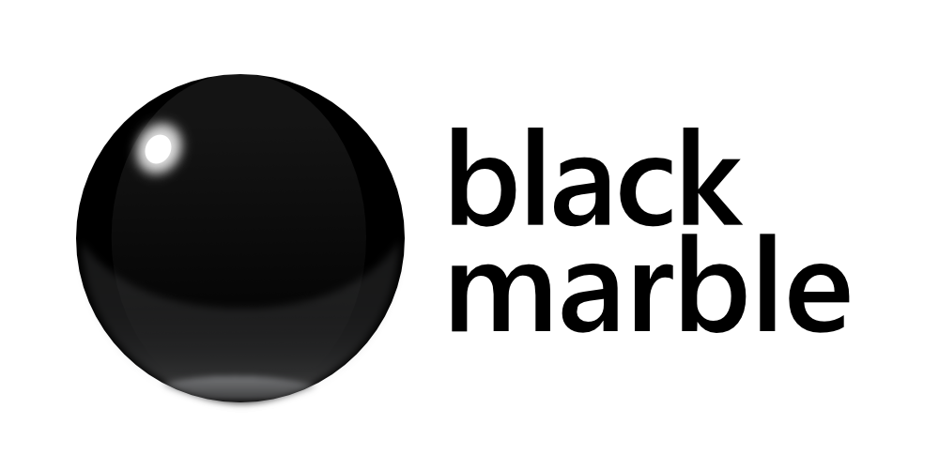

Intro to Microsoft Bot Framework
@dotnetnotts
James Mann
Microsoft MVP & Development Consultant
Black Marble @jamesemann
MICROSOFT
Notes:
Today we are going to look at creating Bots with Microsoft Bot Framework.
Because I am a .NET developer, the examples I will show you today are in C#. But everything you see here can be done with Node JS as well.

Slide 2


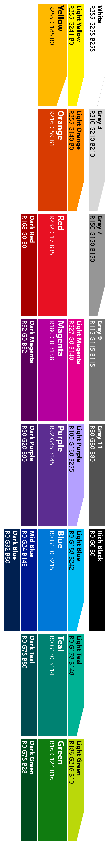
Agenda
Introduction
Why bots?
What is Bot Framework
Dialogs
Formflow
QnA Maker
Bot smarts
luis.ai
Cards
Proactive Bot
Notes:
So how do we deliver this ‘layering’?
We use dialog transitions
There’s more , but these are the important ones

Slide 3
Code + recorded demos + slides
https://github.com/jamesemann/dotnetnotts
Notes:
So how do we deliver this ‘layering’?
We use dialog transitions
There’s more , but these are the important ones

Slide 4
What is a chatbot?
@jamesemann
Notes:
Helpful to understand what a chatbot actually is because the term bot is quite overloaded
So by way of example you will see that

Slide 5
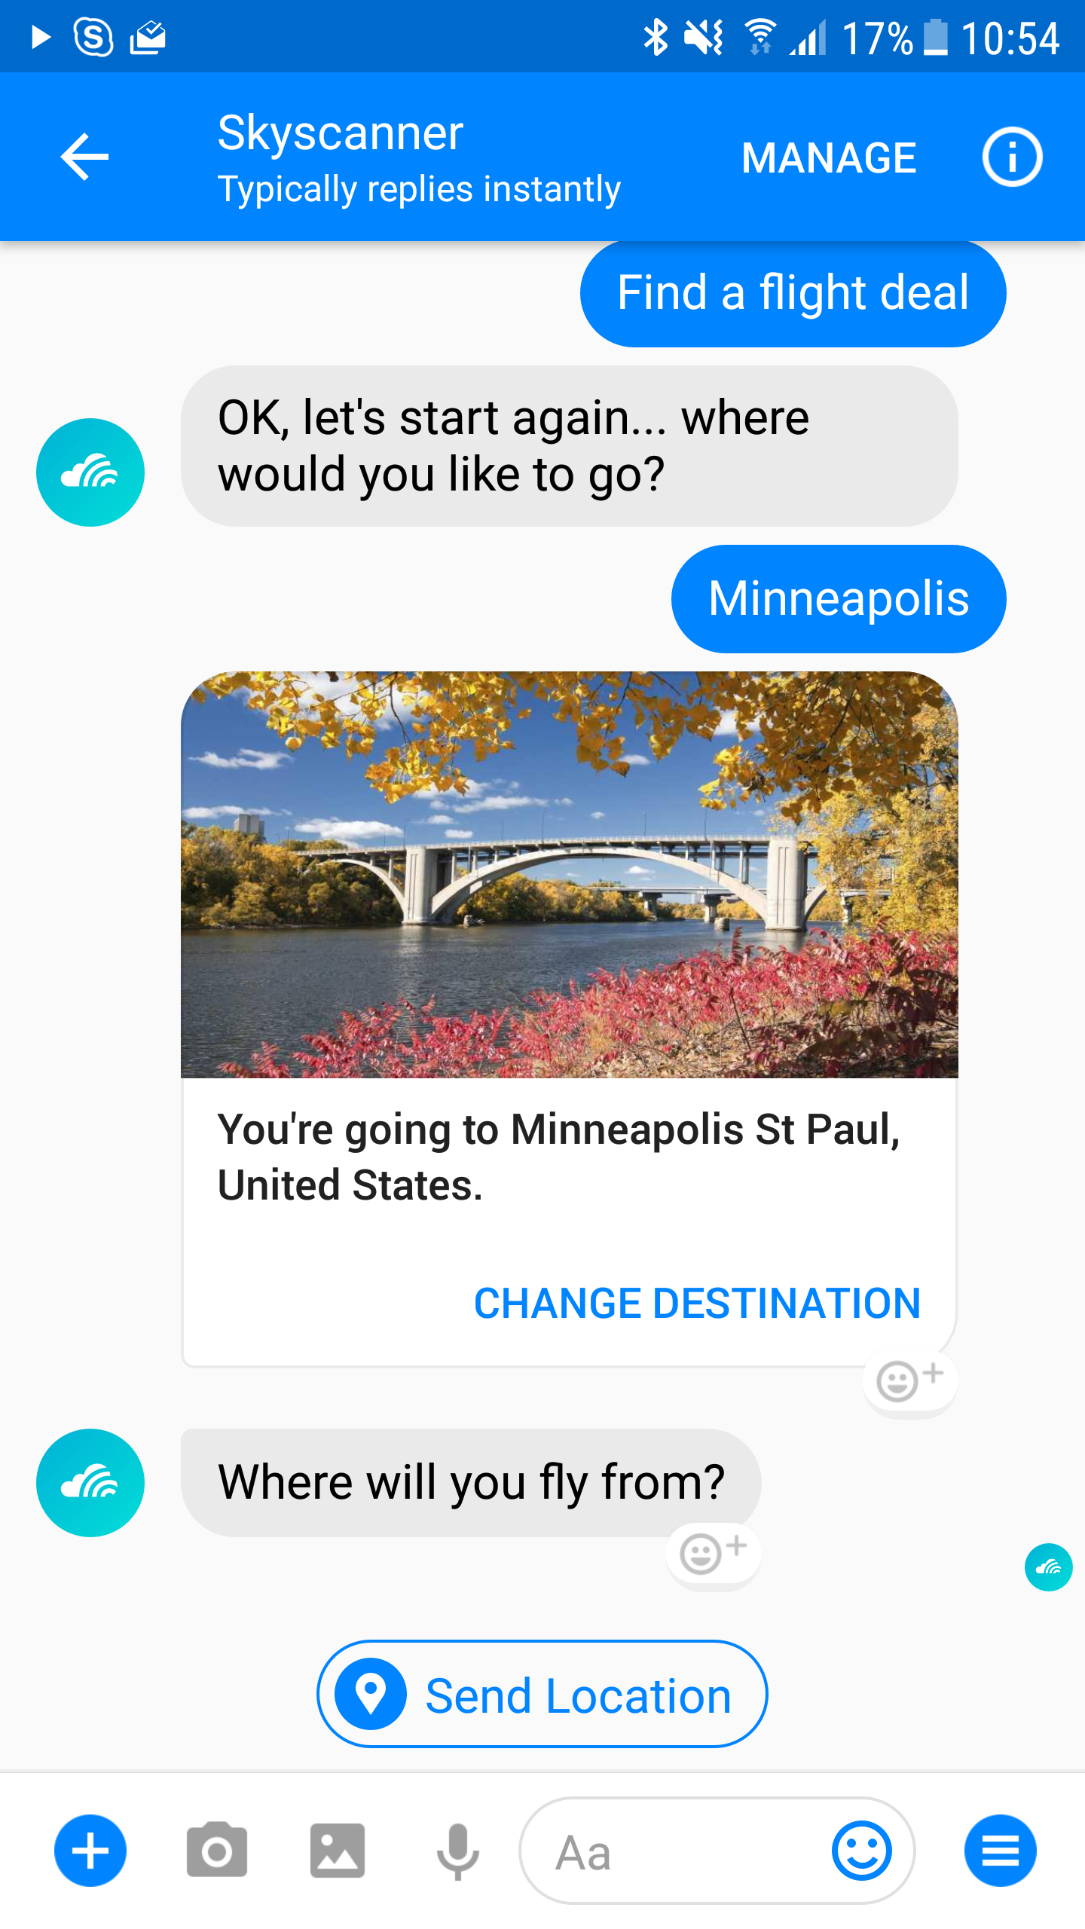
Notes:
I am calling a bot, a software application that is delivered over messaging applications
This may use a conversational interface, or command and control
This example is skyscanner, it lets you find out about flights without installing any software
It’s a nice natural—in this case conversational– interface
That has a really low barrier to entry.

Slide 6

Notes:
But also consider less conventional applications “accessible through email” as bots as well
x.ai is a popular scheduling assistant, that can help avoid scheduling ping pong between meeting participants. Microsoft have a similar email scheduling bot calendar.help

Slide 7
Why chatbots?
@jamesemann
Notes:
That was a quick definition of a bot, so lets talk about why they have become popular

Slide 8
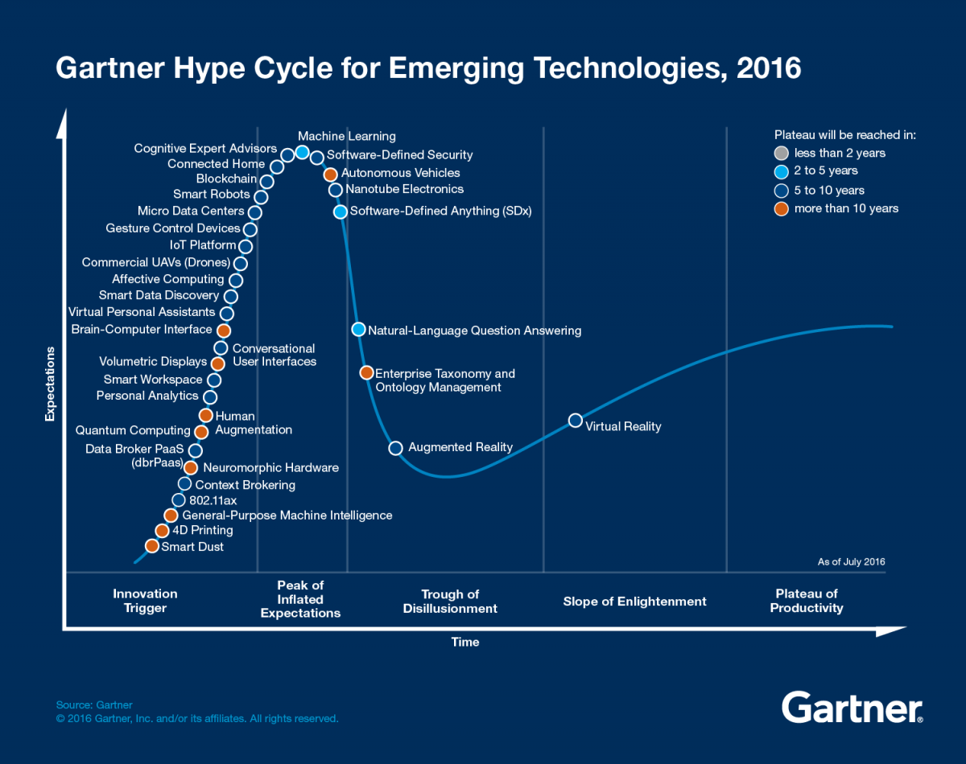
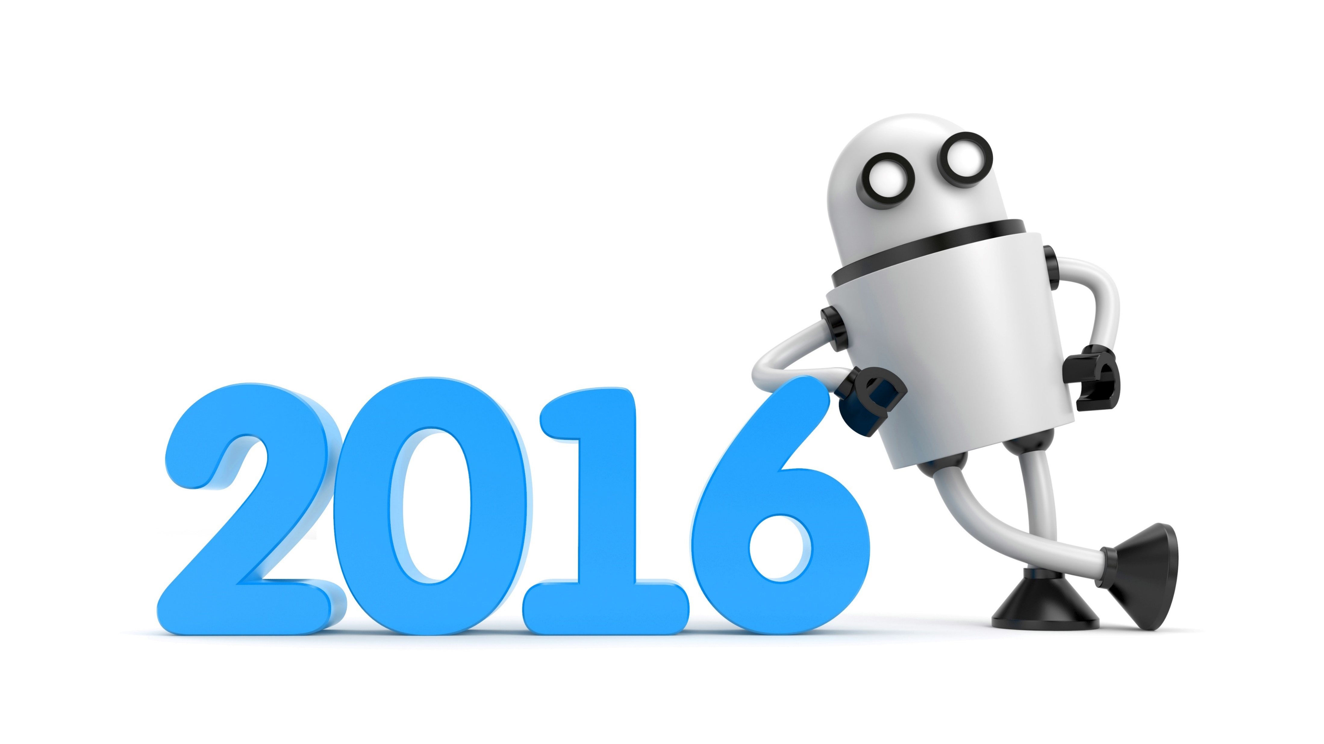
Hype mostly around distribution
But also.. natural language and the AI landscape
Year of the chatbot
Notes:
2016 was called year of the bot,
In 2016 you can see Conversational User interface and Virtual Personal Assistants are on the innovation trigger heading up to the peak of inflated expectations.
Interestingly, Gartner predict that the hype wont plateau for 5-10 years. So the hype rollercoaster is set to continue for a couple more years at least.
Why is it so interesting? Lets take a look
Most cited reasons:
#1 distribution
#2 better experience?? (engage with the chat generation)

Slide 9
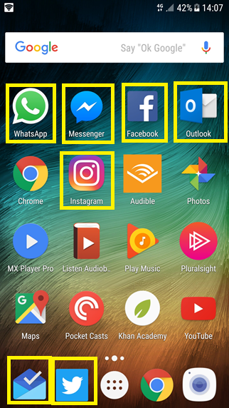
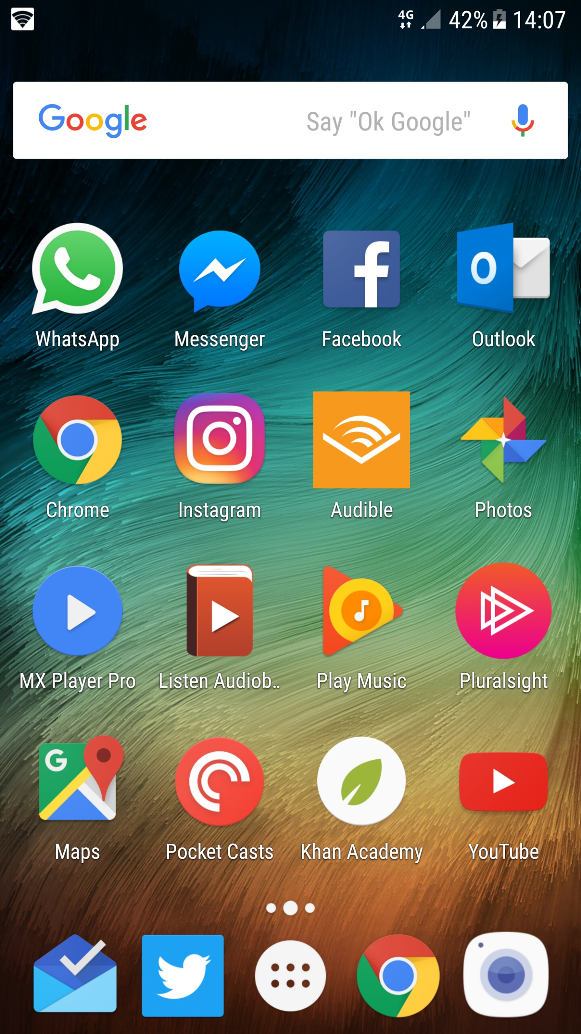
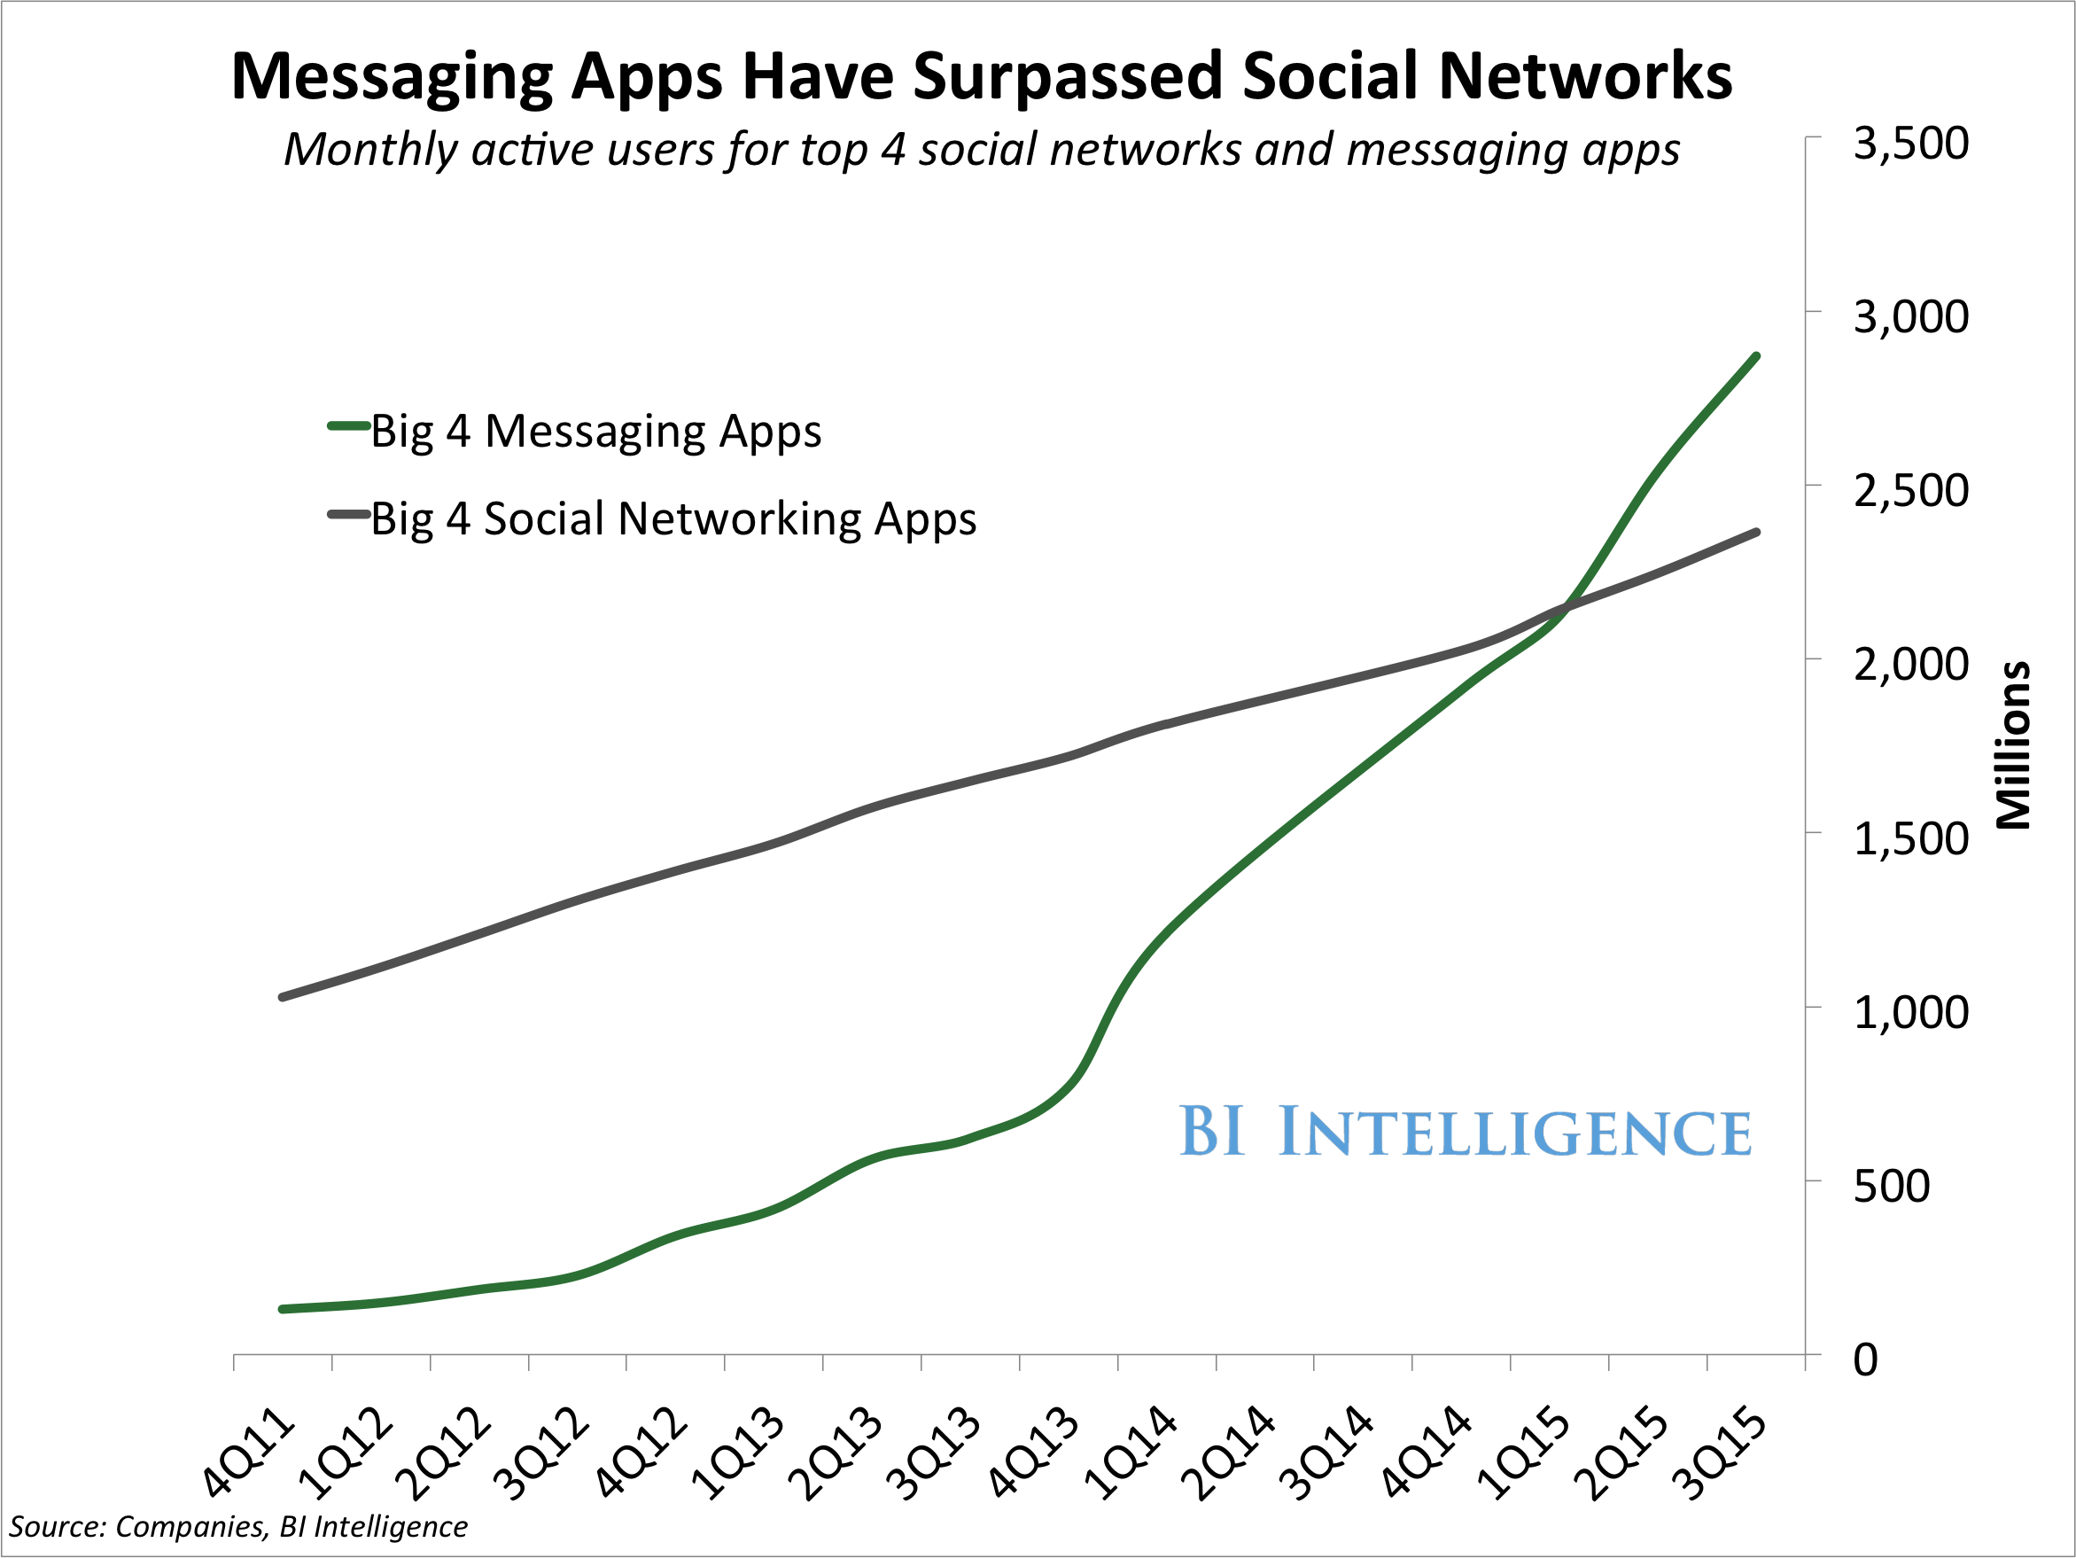
Distribution
Over 4 billion global users using messaging platforms
6 out of the top 10 apps used globally are messaging apps
Notes:
So the big selling point is distribution.
Everyone has a device on them. People are addicted to their phones, and particularly messenger apps.
Chatbots take advantage of this by using messenger apps and virtual assistants to reach users where they are already active.
Take a look at your phone home screen. Count how many messaging/assistant apps you have on there. Count things like email too because you have seen that chatbots can be delivered across all these channels.
It’s a really compelling distribution story and I think it is the number one reason for chatbot hype.

Slide 10














Messaging ecosystem
Notes:
So digging into it from a bot framework perspective. There are 12 messaging channels supporting messaging apps and virtual assistants. 3 new channels were announced at //BUILD –
Bing search
Skype for business
cortana

Slide 11
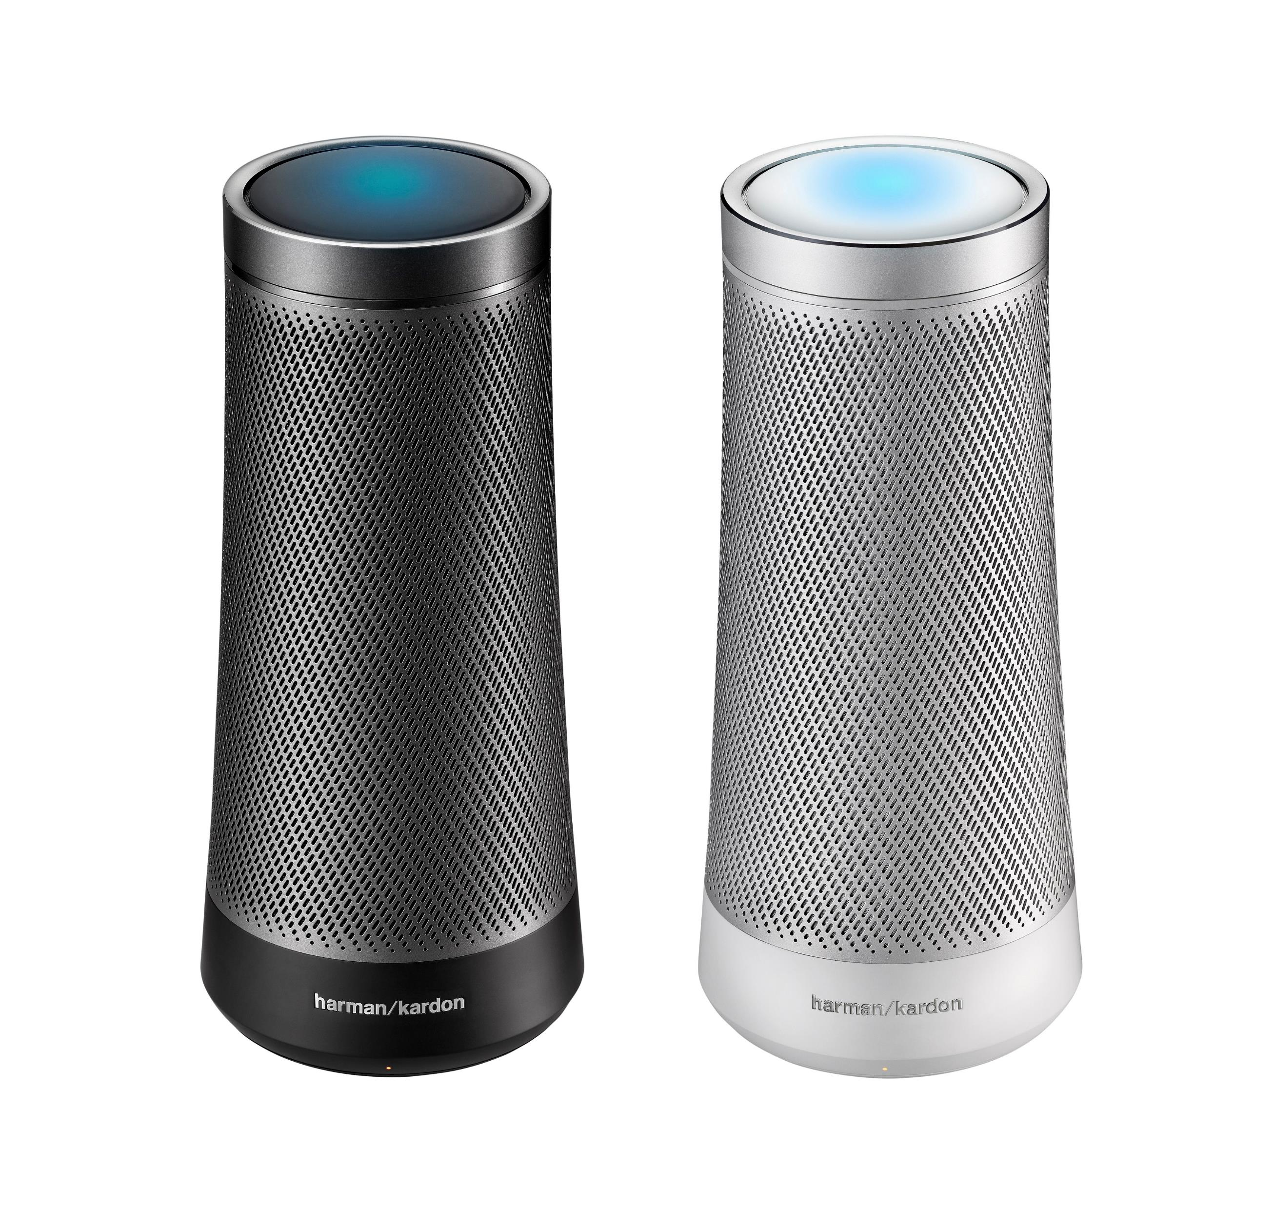
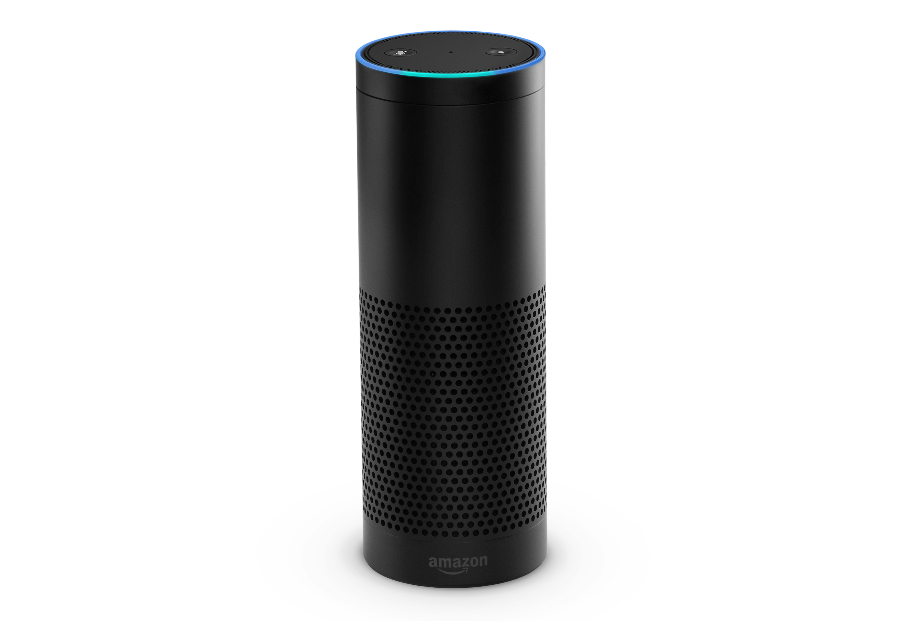
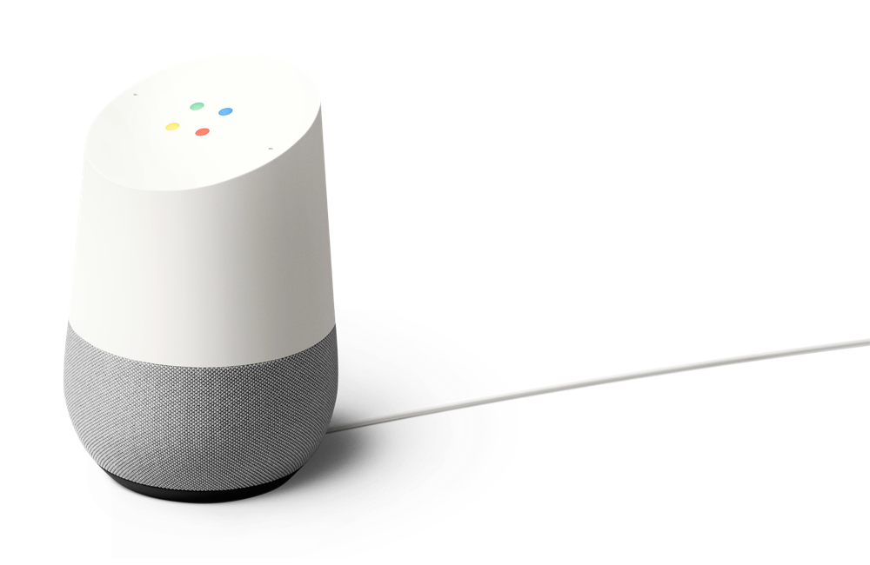
Virtual assistant device ecosystem
Notes:
And these dedicated virtual assistant devices are becoming mainstream.
Everyone has seen the examples GOOD and BAD of amazon alexa.
Google home has recently become available in the UK
And dedicated cortana devices are on their way.

Slide 12
Use cases are everywhere
Customer Service
Shopping Experience
Help Desk
Employee Support
FAQ
Account queries
Resolve order issues
Parcel Tracking
Transport queries (bus, train)
Recommend product
Flight, hotel booking
Improving search
Find the right product
Problem troubleshooting
New user on-boarding
Response suggestion
Product information
Data insights
Find the right expert
HR – booking holiday, fault reporting
Meeting room booking
Notes:
So there are tons of use cases for chatbots. Some are just delivering existing functionality through a new experience, but others, like x.ai are bot first applications, made possible with the distribution and channel capabilities.
Not every use case is appropriate though. Bots tend to work very well when the application is precise.
Here I’ve highlighted an example of a use case that doesn’t work very well. If you think of how a lot of people shop, they don’t typically have a specific product already in mind. They want to maybe browse a catalogue, and discover and get a wide range of inspiration before narrowing down their product. Chatbots make this difficult because the canvas capabilities require information to be more precise.

Slide 13
What is Bot Framework?
@jamesemann
Notes:
Introductions and Agenda (2 Mins)
Introduce Simon, Gary, James
Set expectations: intro to bot framework.
Very quick demo of JUST EAT to show what a bot is
What we are going to cover

Slide 14
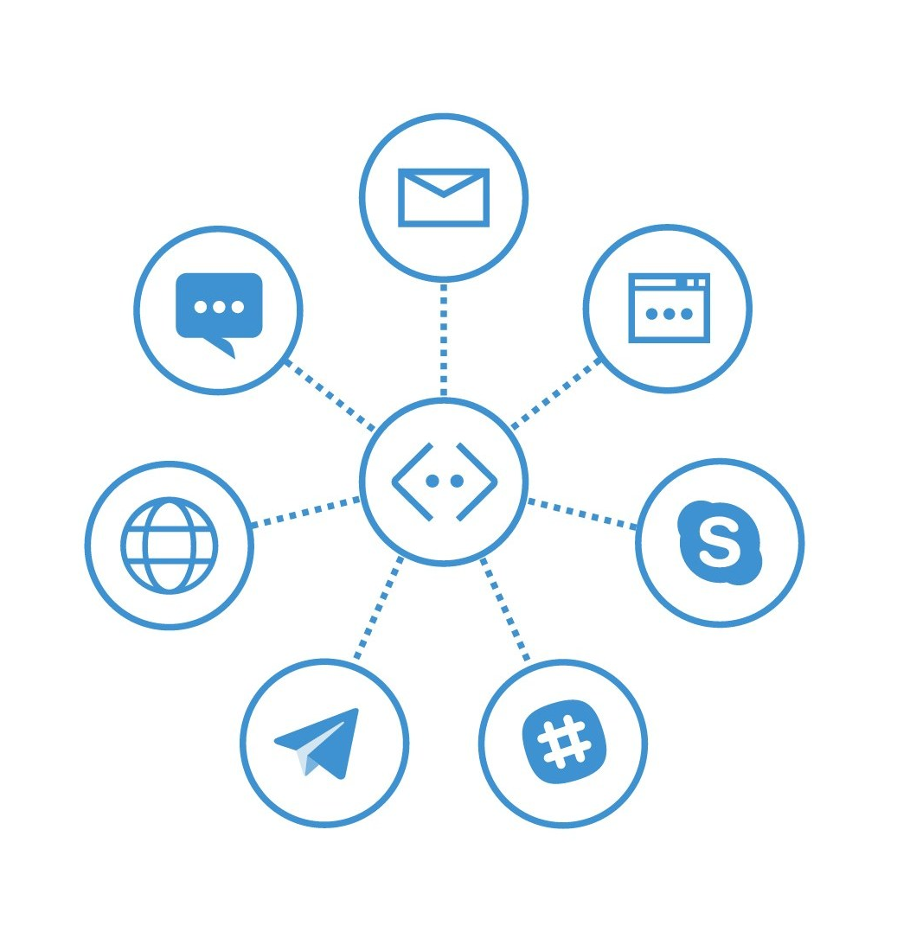
Bot Framework
Build one Bot
Host one Bot
Maintain one Bot
Target multiple channels
Notes:
So how do we deliver this ‘layering’?
We use dialog transitions
There’s more , but these are the important ones

Slide 15
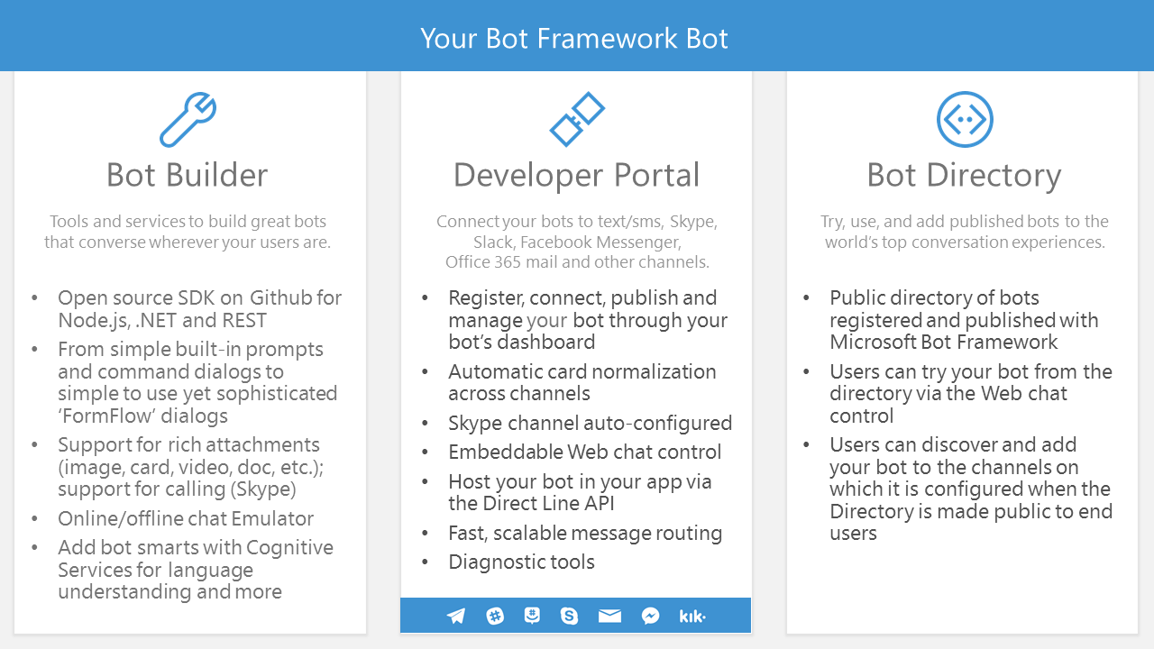
Bot Framework
Your Bot Framework Bot
Notes:
So how do we deliver this ‘layering’?
We use dialog transitions
There’s more , but these are the important ones

Slide 16
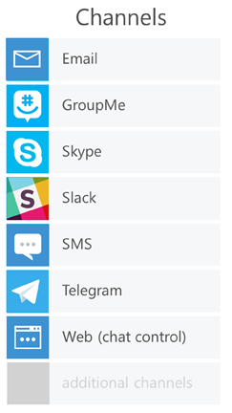
Bot Framework Architecture
Your Bot’s web service
Bot Connector
Routes messages
Manages state
Bot registration, directory
Session tracking
Services (translation…)
Per-user, per-bot storage
SDK, APIs
Your Bot logic
Bot Builder SDK (Node.js + C#)
Notes:
So how do we deliver this ‘layering’?
We use dialog transitions
There’s more , but these are the important ones

Slide 17
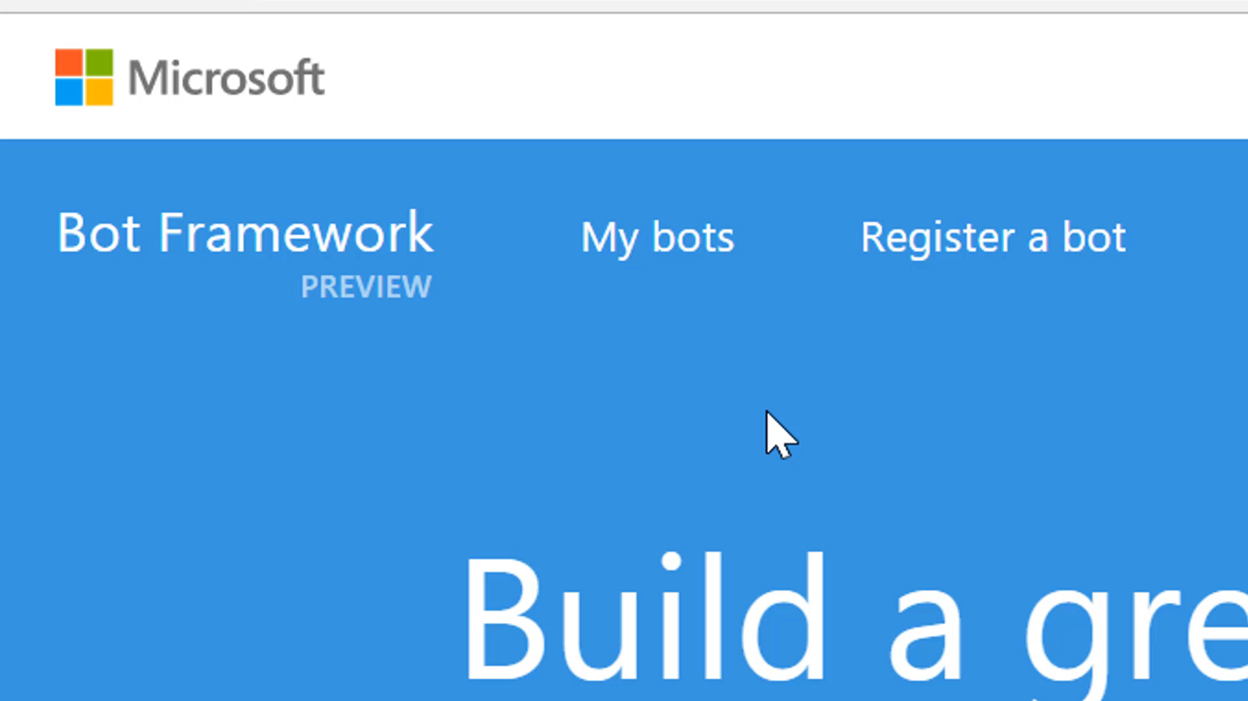
Register
Register
Register your Bot Application through the
Bot Framework Portal
Notes:
First you register the Bot.
You give your bot a name, an icon, provide an API endpoint that it will talk to.

Slide 18
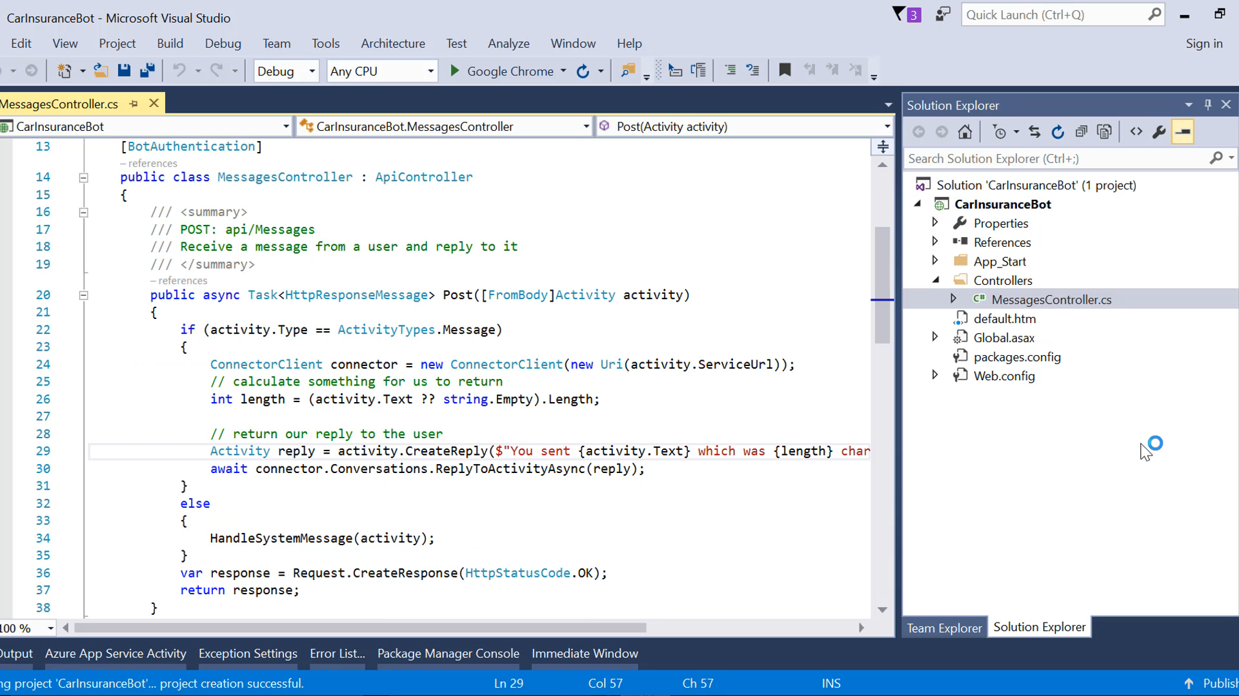
Register
Build
Build your Bot using
C# or Node JS
Notes:
First you register the Bot.
You give your bot a name, an icon, provide an API endpoint that it will talk to.

Slide 19
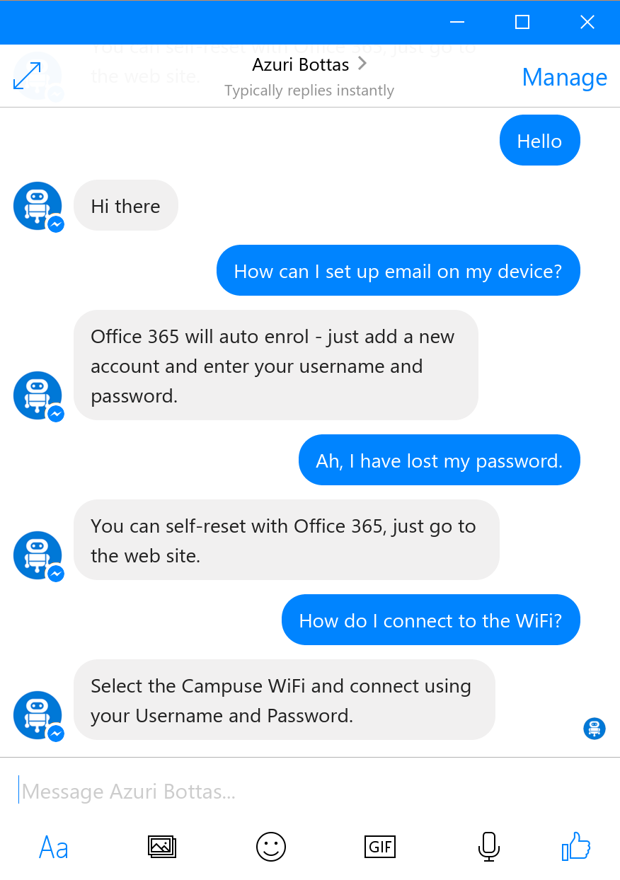
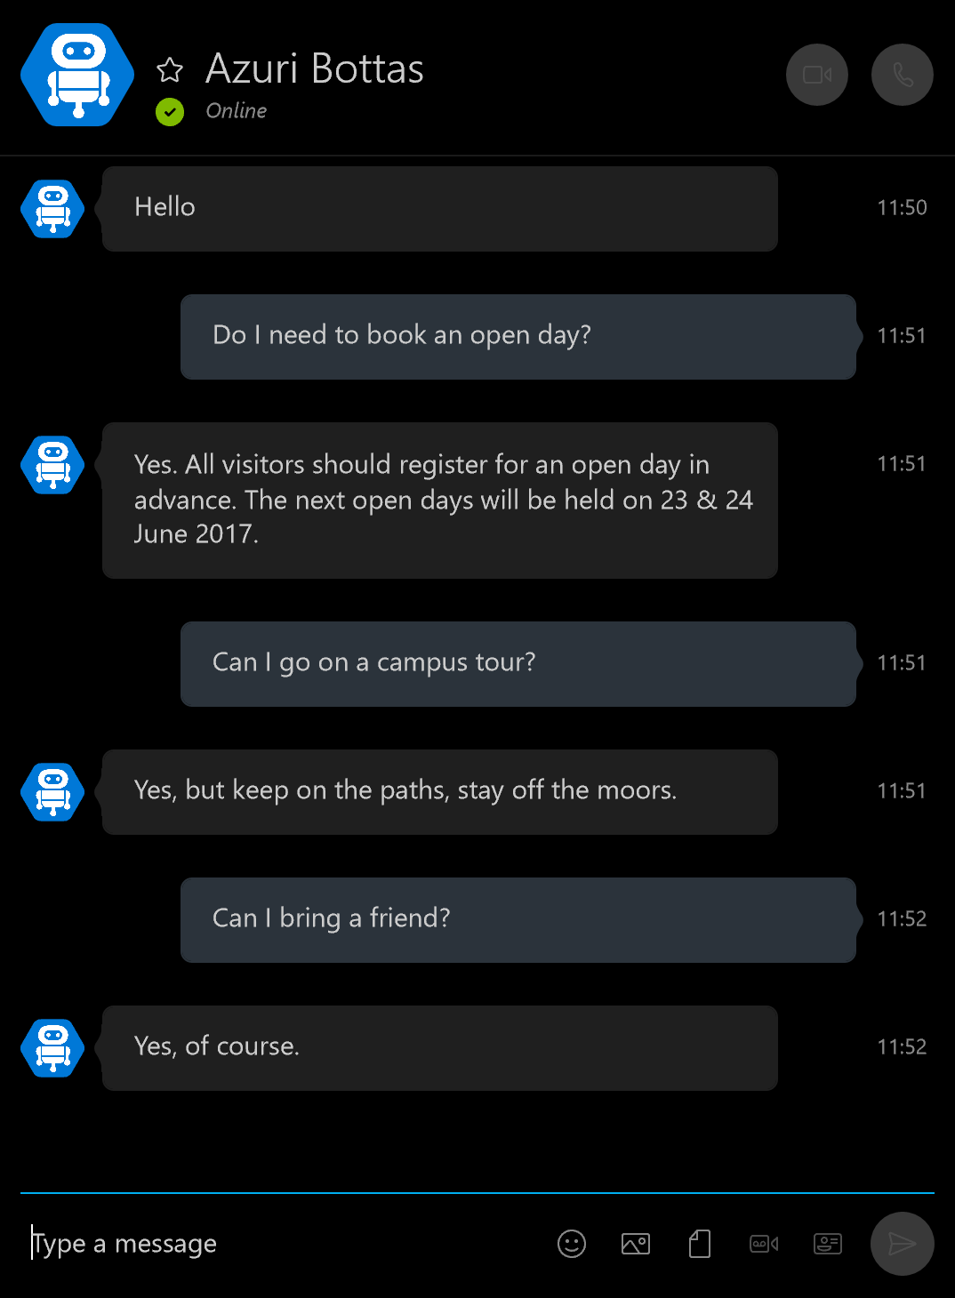


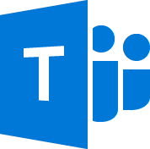






Distribute
Facebook
Skype
& more!
Notes:
Then you distribute.
This is all done by turning on the channel in the portal. once you have defined your Bot application and does not require code changes!
Here I am exposing my bot over facebook, then skype,
I can choose at any time, to distribute to any of the other channels currently supported by Bot framework.
And – a key benefit – if channels are added in future – my bot is already future proof!

Slide 20
Demo
Your first Bot
@jamesemann
Notes:
Introductions and Agenda (2 Mins)
Introduce Simon, Gary, James
Set expectations: intro to bot framework.
Very quick demo of JUST EAT to show what a bot is
What we are going to cover

Slide 21
Modelling your conversation
Roll your own
state management etc
Multi layered conversations
Bespoke
Dialogs
Data capture,
“Web forms” scenarios
Flexibility
FormFlow
Questions and answers (FaQ),
Command and control
QnA
Effort to implement
Notes:
So when you are first starting your conversation, you have a decision to make about which tools you use.
This depends on the type of conversation.
I’ve tried to show this in the diagram
along the bottom is the amount of effort required to implement.
Along the side is the amount of flexibility
So basically,
if you have a simple bot scenario you are going to be looking at the bottom left
If you have a complex scenario you are going to be looking at the top right
We are going to be focussing on Dialogs, which gives you benefits of state management, persistence etc while giving you a good level of flexibility

Slide 22
Dialogs
@jamesemann
Notes:
Introductions and Agenda (2 Mins)
Introduce Simon, Gary, James
Set expectations: intro to bot framework.
Very quick demo of JUST EAT to show what a bot is
What we are going to cover

Slide 23
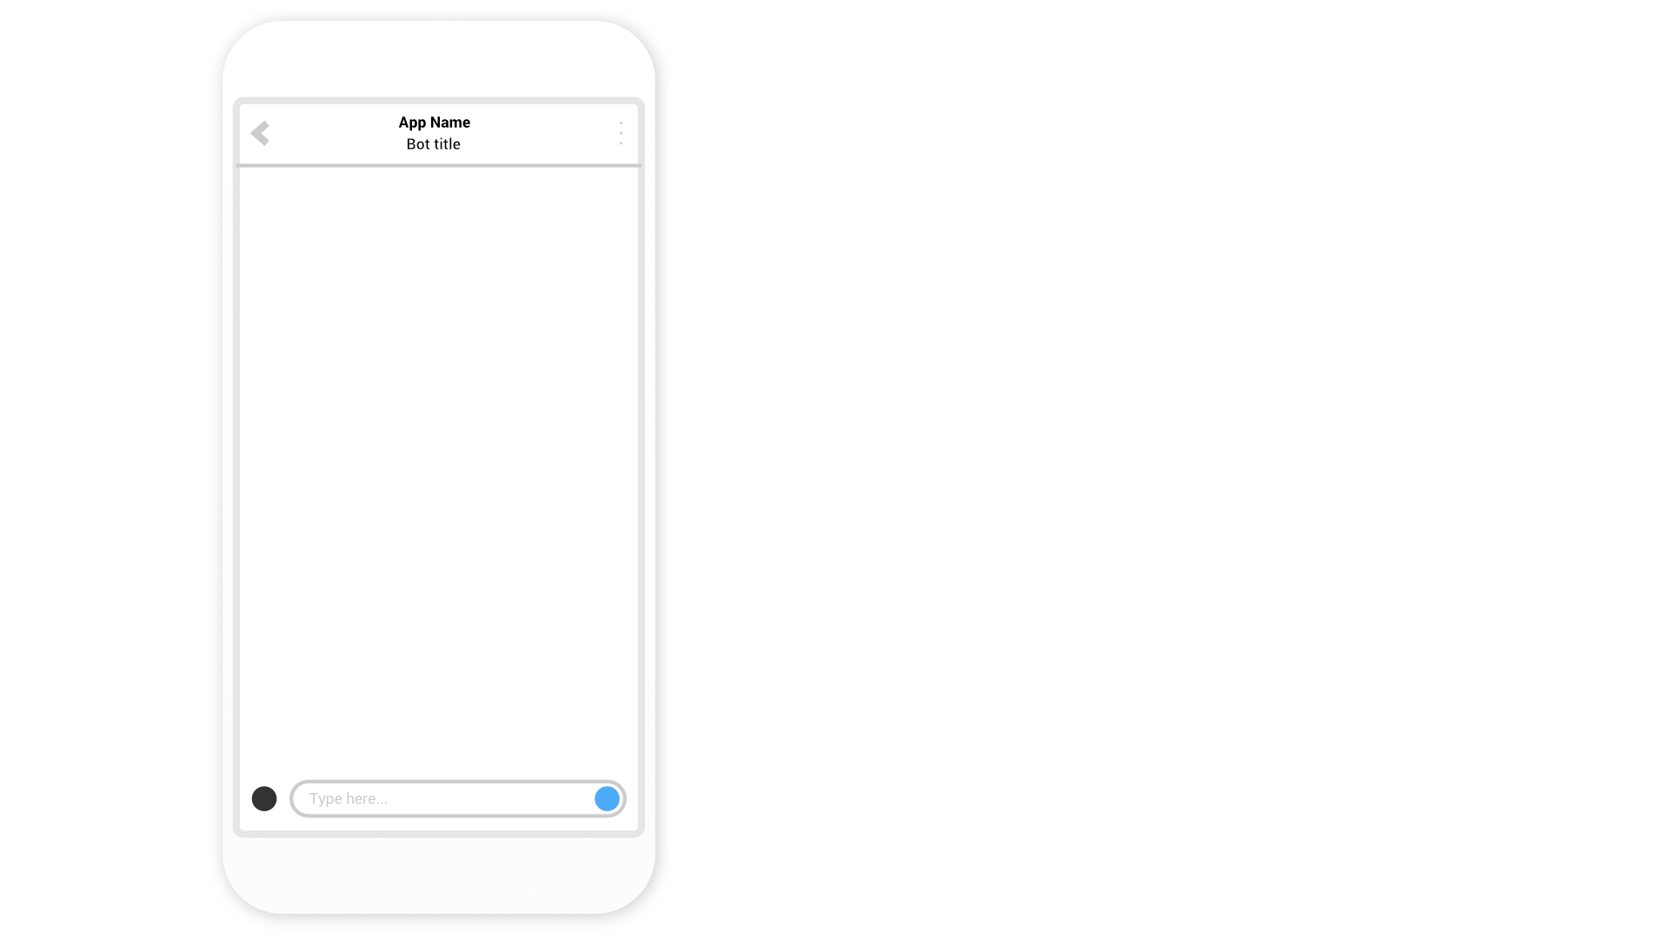
Notes:
Talk through an example of a BANKING BOT
Can do a couple of simple tasks
Check balance (savings or current)
And make a payment

Slide 25
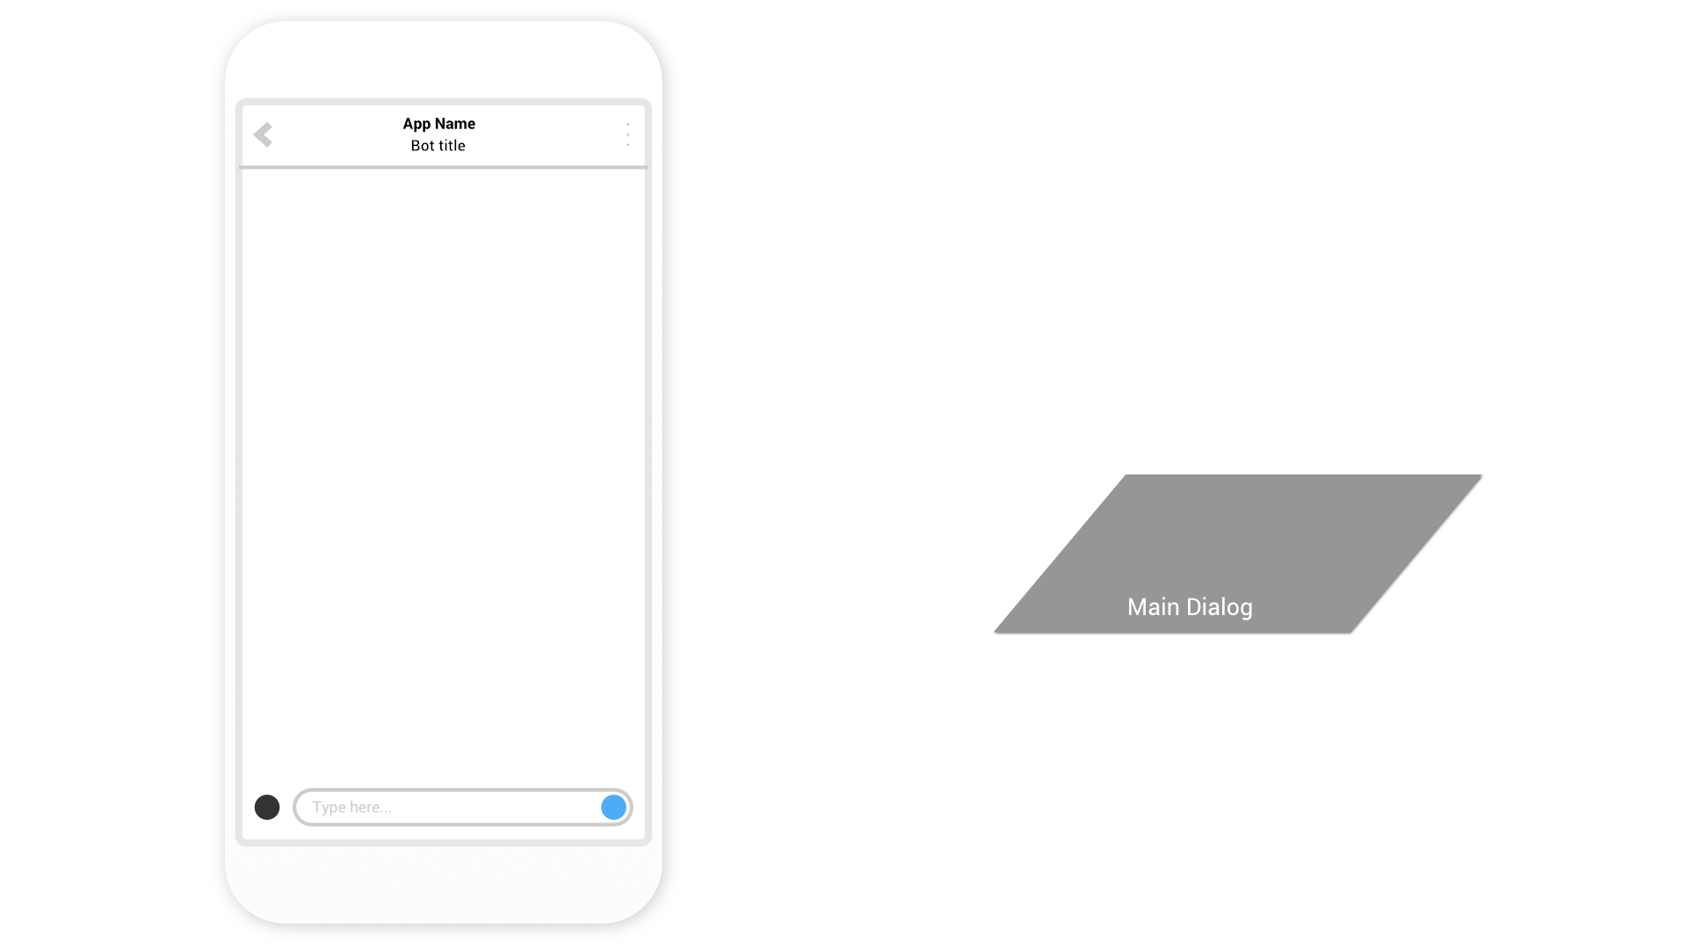

Slide 26


Slide 27
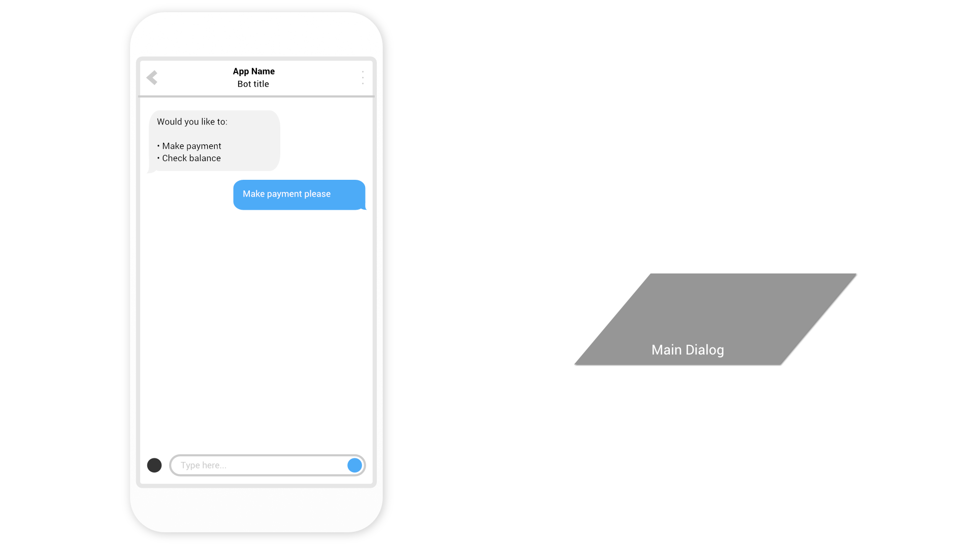

Slide 28
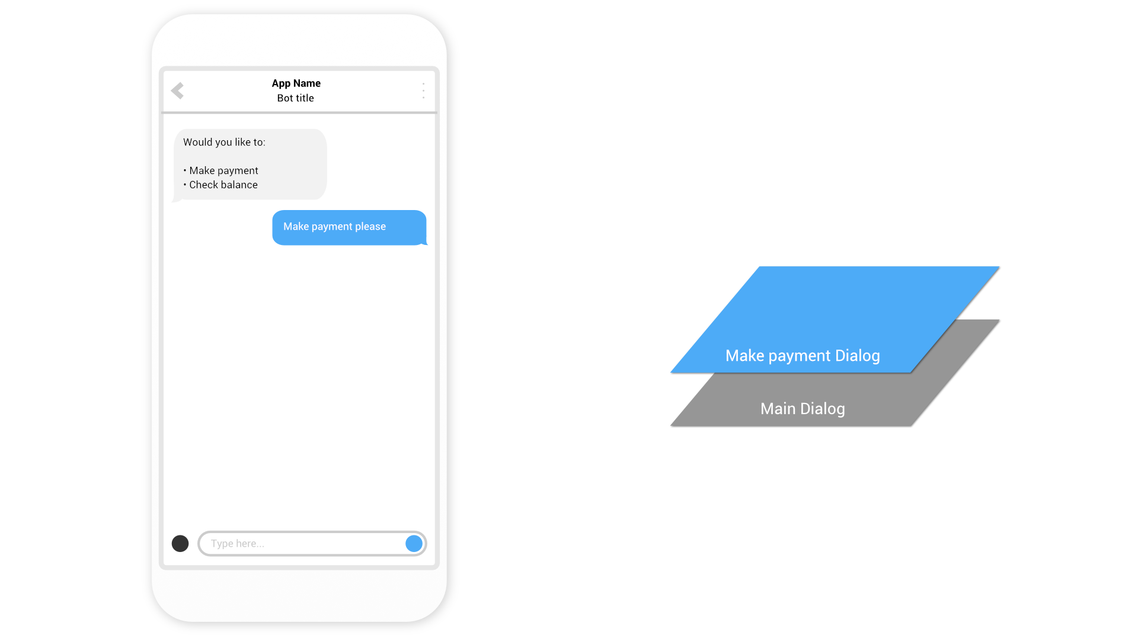

Slide 29


Slide 30
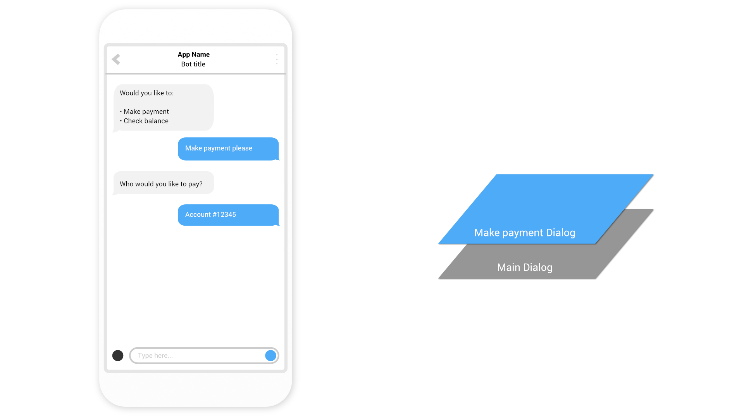

Slide 31


Slide 32
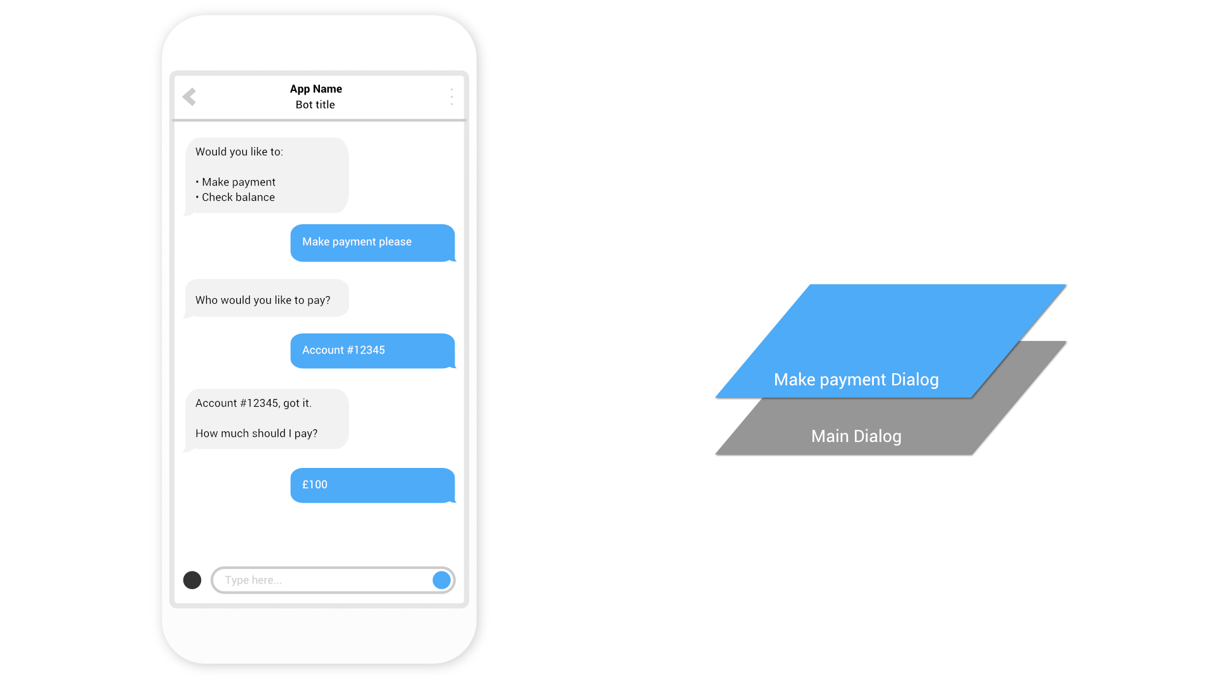

Slide 33
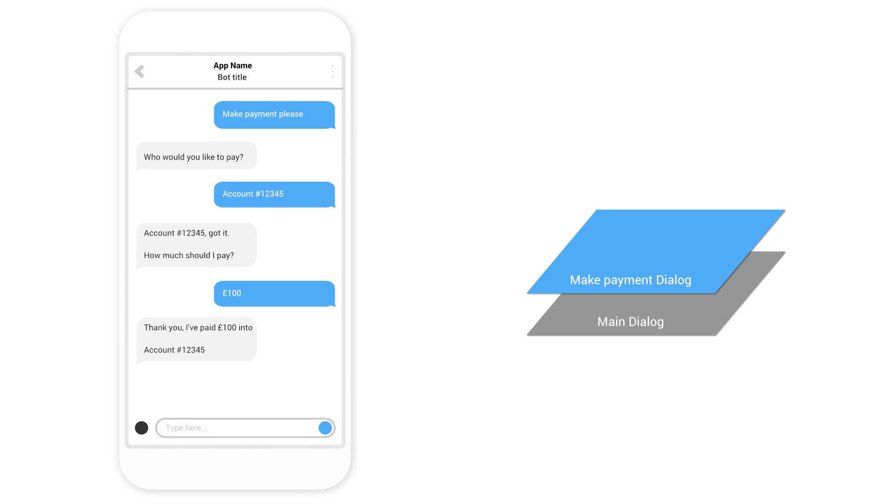

Slide 34
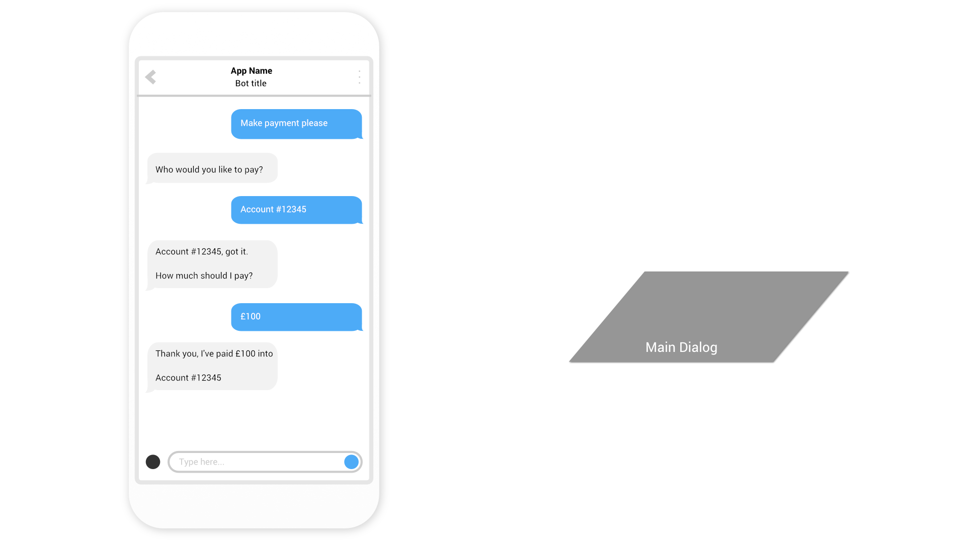

Slide 35
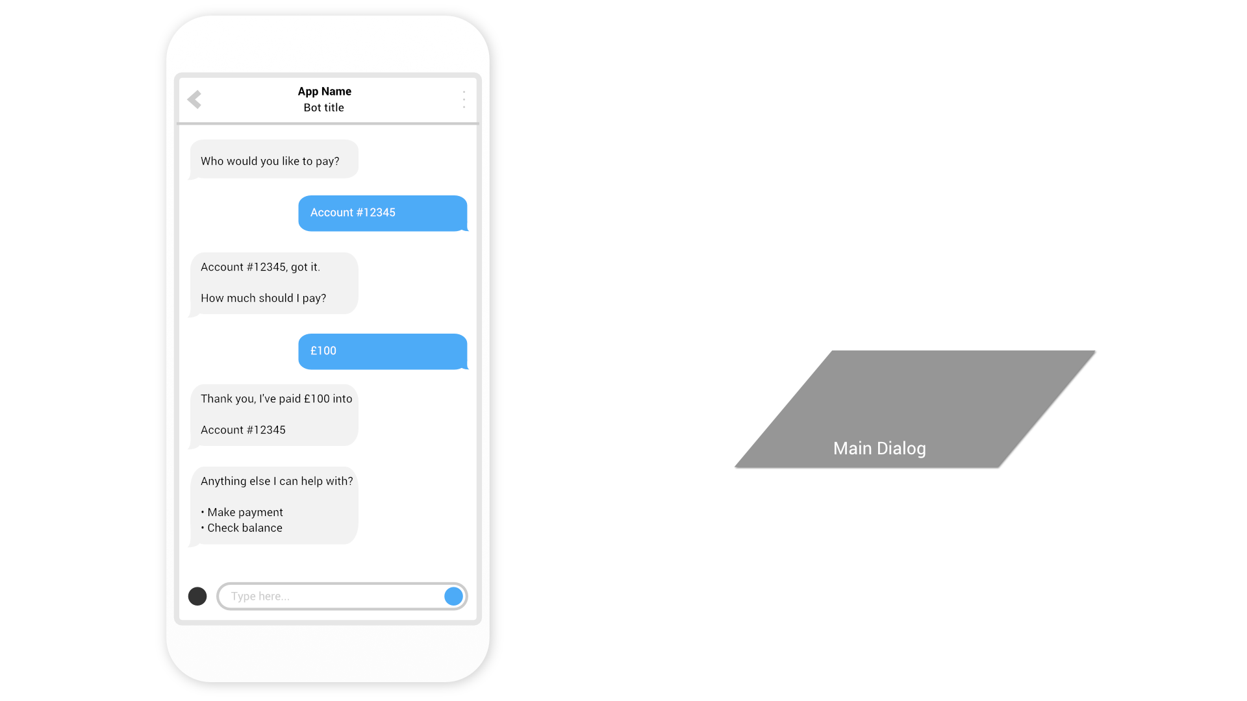

Slide 36
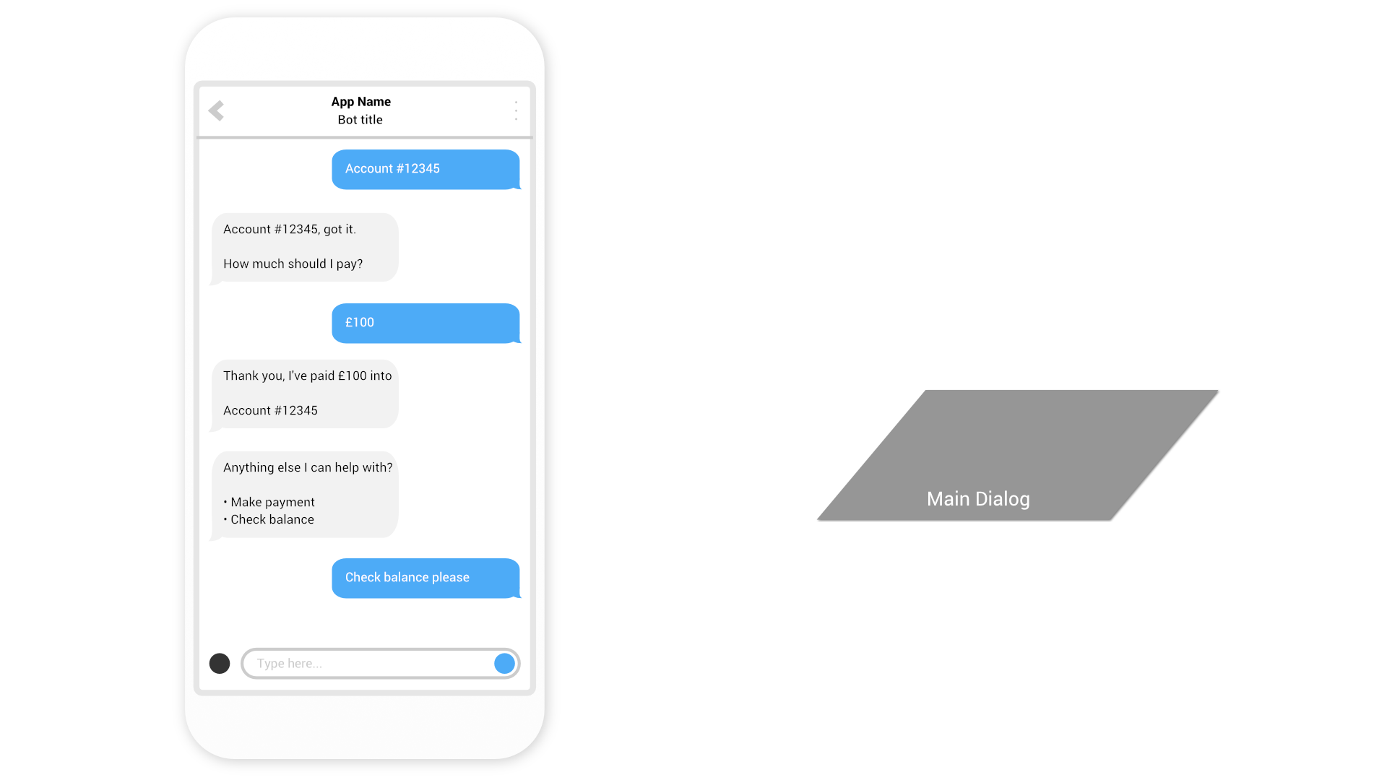

Slide 37
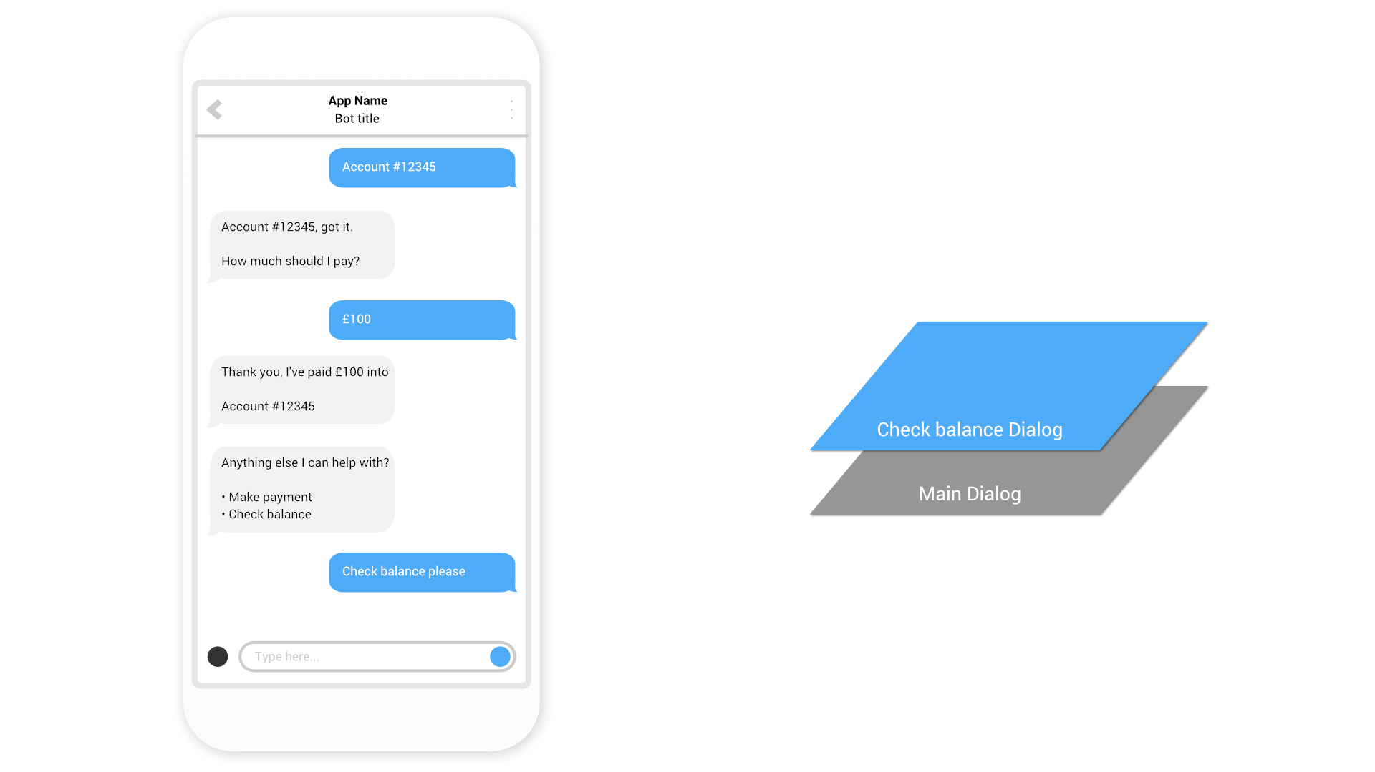

Slide 38
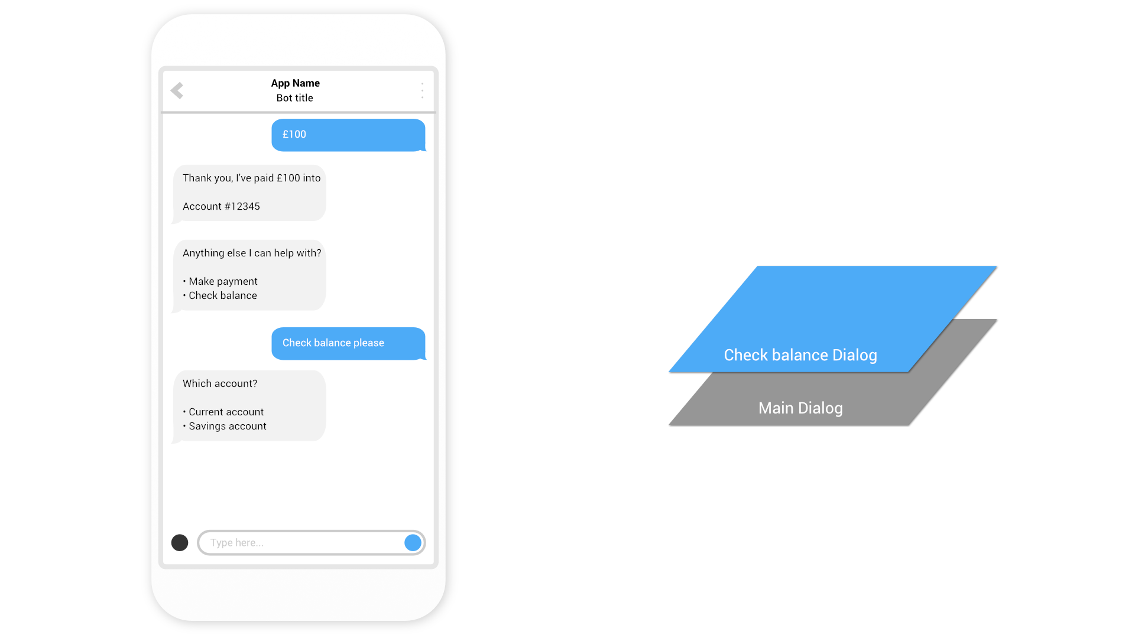

Slide 39
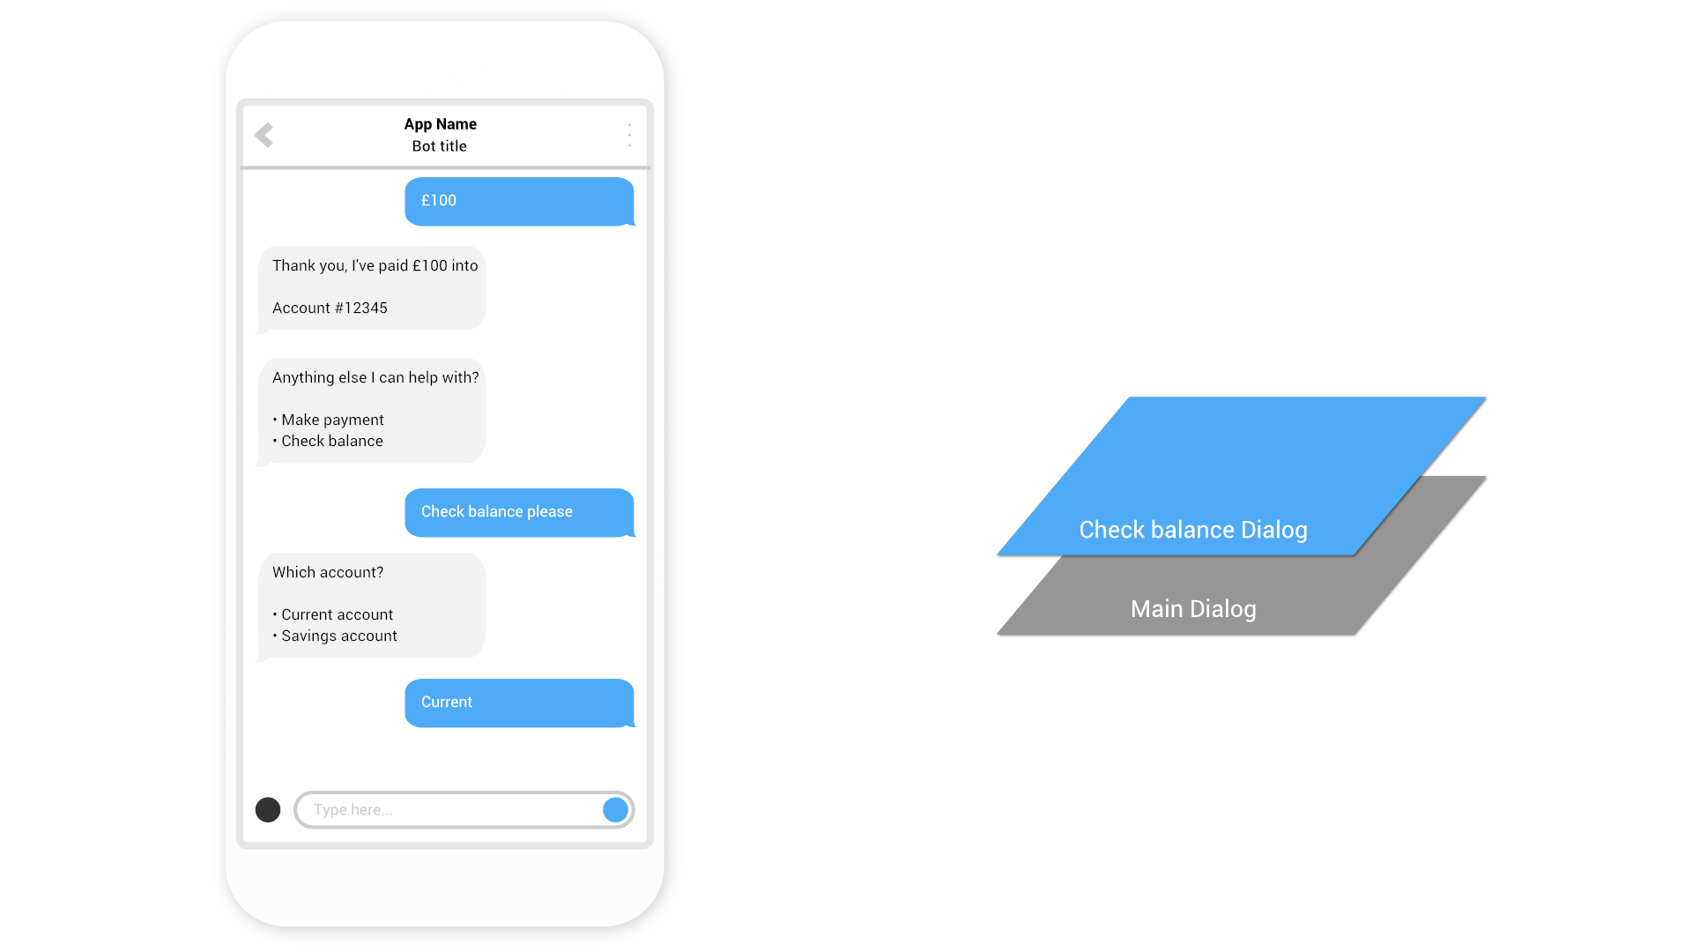

Slide 40
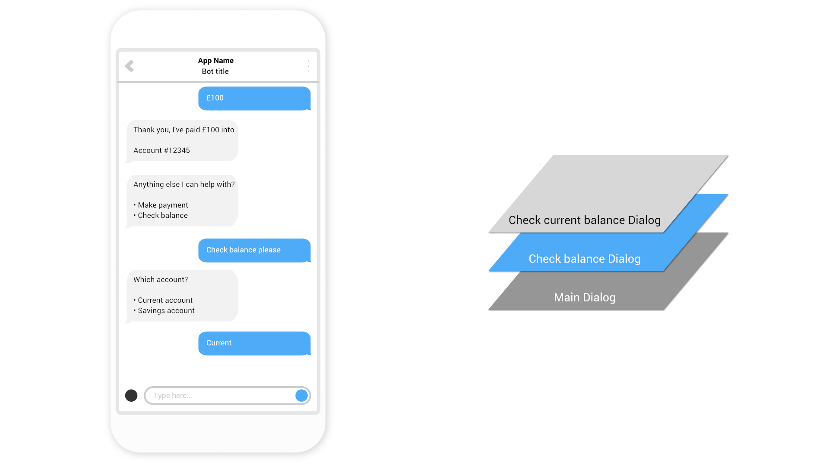

Slide 41
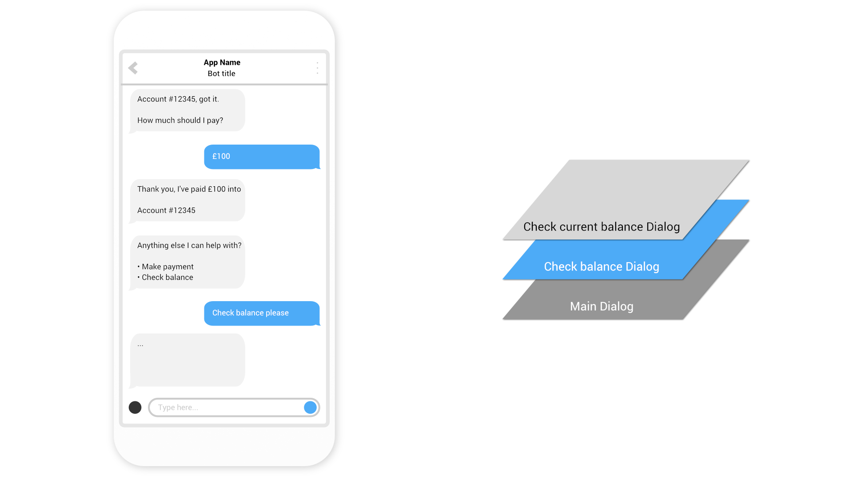

Slide 42
Dialog transitions
Context.Wait()
Wait for a user to send a message in the same Dialog
Context.Call() & Context.Forward()
Call another Dialog, adding it to the top of the stack, with or without passing a message to the child Dialog.
Context.Done()
Complete the current Dialog, removing it from the stack
Notes:
So how do we deliver this ‘layering’?
We use dialog transitions
There’s more , but these are the important ones

Slide 43
Demo
Banking Bot using Dialogs
@jamesemann
Notes:
Introductions and Agenda (2 Mins)
Introduce Simon, Gary, James
Set expectations: intro to bot framework.
Very quick demo of JUST EAT to show what a bot is
What we are going to cover

Slide 44
Form Flow
@jamesemann
Notes:
Introductions and Agenda (2 Mins)
Introduce Simon, Gary, James
Set expectations: intro to bot framework.
Very quick demo of JUST EAT to show what a bot is
What we are going to cover

Slide 45
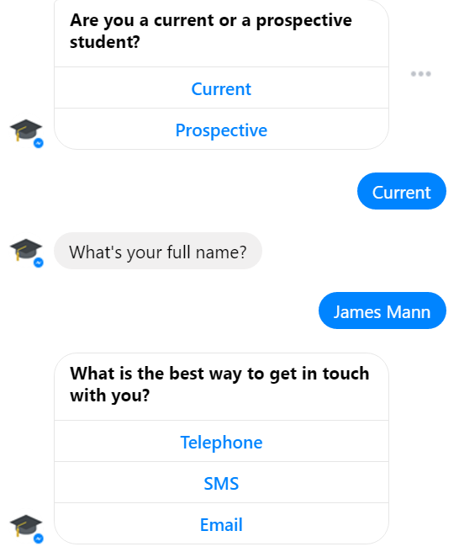
Form Flow
Form Flows are suited to data capture
Similar to a form in a traditional web page
Very simple to implement

Slide 46
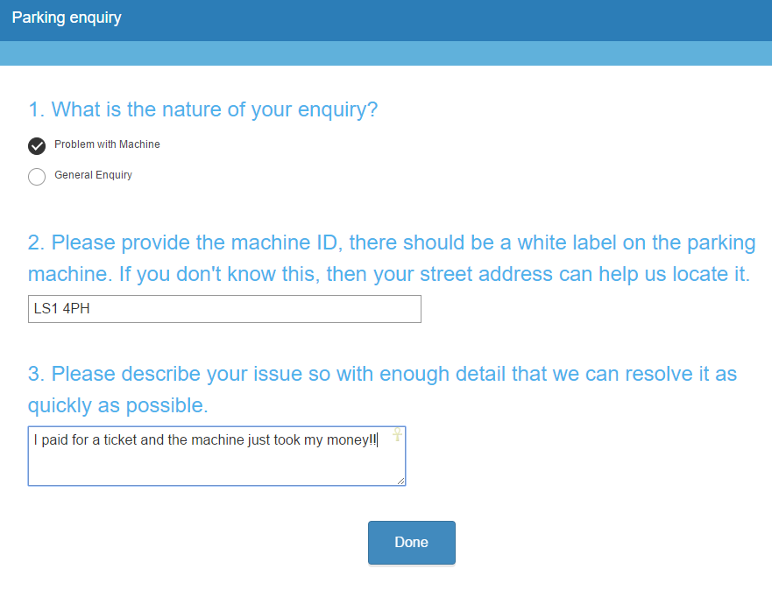
Parking enquiry chatbot
Notes:
So I wanted to put together an example here where users can log a parking enquiry – currently through a webform.
There are three simple fields, basically a checkbox saying what kind of enquiry the user as, then a field for the location, and another field detailing the product.
When the user fills it in they are shown the typical confirmation page. People are often felt like they are left hanging especially if they have a urgent enquiry

Slide 47
Demo
Form Flow Bot
@jamesemann
Notes:
Introductions and Agenda (2 Mins)
Introduce Simon, Gary, James
Set expectations: intro to bot framework.
Very quick demo of JUST EAT to show what a bot is
What we are going to cover

Slide 48
QnA Maker
@jamesemann
Notes:
Introductions and Agenda (2 Mins)
Introduce Simon, Gary, James
Set expectations: intro to bot framework.
Very quick demo of JUST EAT to show what a bot is
What we are going to cover

Slide 49
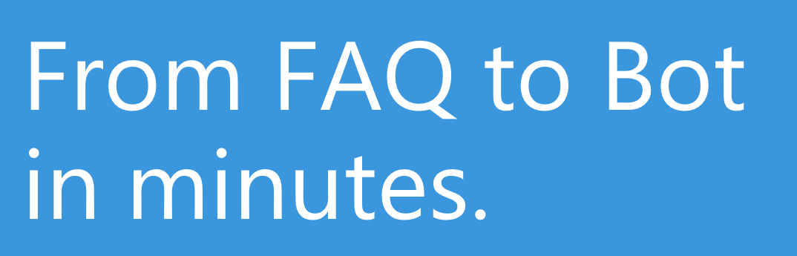

QnA Maker
Build, train and publish
Q&A bots based on existing FAQs
https://www.qnamaker.ai
Notes:
Common requirement for chat bots to surface answers to common questions
QnA Maker Service trains AI to respond to questions in a natural conversational way
Integrates easily with bots built using the Bot Framework – it is just a REST based API
Really easy way to get a bot up and running and start seeing the benefits!
http://qnamaker.ai
------------------------------------------------------
Brief overview of the QnA maker
Sign into qnamaker.ai
Create a new service using https://azure.microsoft.com/en-gb/support/faq/
Try "What does it mean if a service is in preview" -> show that we receive the right answer
Talk about training
Try "How do I raise a support request?" -> We get an answer but not the right one. Let's type "How do I submit a support request?" -> Get the right answer and add "How do I raise a support ticket?" as alternative phrase and re-train
Now try "How do I create a ticket with support?" -> get the right answer
Publish the service
Switch to bot demo in VS and show how we are calling our QnA Maker service and demo the bot
Maybe show my QnAMakerDialog available on NuGet??? YES

Slide 50
Demo
qnamaker.ai
@jamesemann
Notes:
Introductions and Agenda (2 Mins)
Introduce Simon, Gary, James
Set expectations: intro to bot framework.
Very quick demo of JUST EAT to show what a bot is
What we are going to cover

Slide 51
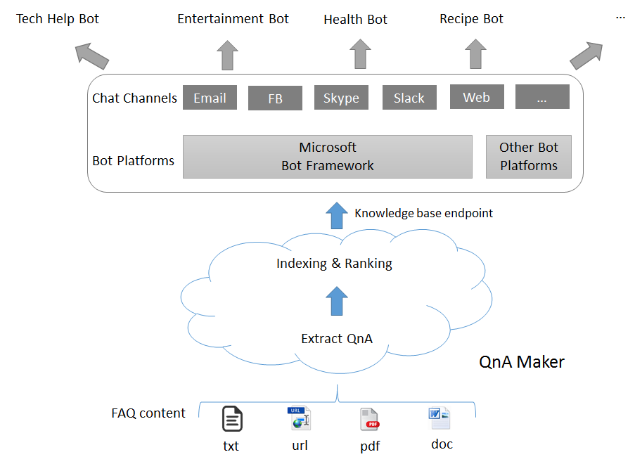
Demo
Banking bot using Dialogs
@jamesemann
Notes:
Introductions and Agenda (2 Mins)
Introduce Simon, Gary, James
Set expectations: intro to bot framework.
Very quick demo of JUST EAT to show what a bot is
What we are going to cover

Slide 52
Demo
QnA Maker Bot
@jamesemann
Notes:
Introductions and Agenda (2 Mins)
Introduce Simon, Gary, James
Set expectations: intro to bot framework.
Very quick demo of JUST EAT to show what a bot is
What we are going to cover

Slide 53
Agenda
Introduction
Why bots?
What is Bot Framework
Dialogs
Formflow
QnaMaker
Bot smarts
luis.ai
Cards
Proactive Bot
Notes:
So how do we deliver this ‘layering’?
We use dialog transitions
There’s more , but these are the important ones

Slide 54
luis.ai
@jamesemann
Notes:
Introductions and Agenda (2 Mins)
Introduce Simon, Gary, James
Set expectations: intro to bot framework.
Very quick demo of JUST EAT to show what a bot is
What we are going to cover

Slide 55
luis.ai terminology
Utterance (input)
A spoken or written message
Intent (output)
What is the user intending to do?
Entity (output)
What objects are being referred to?
“Set the temperature in the kitchen to 21 degrees”
“Set the temperature in the kitchen to 21 degrees”
“Set the temperature in the kitchen to 21 degrees”
Notes:
There’s more , but these are the important ones

Slide 56
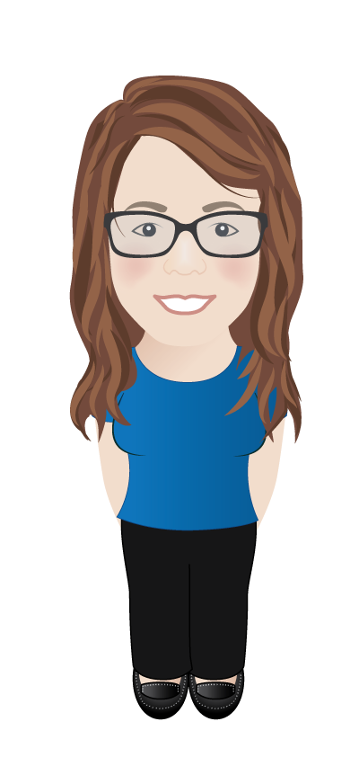
luis.ai intent recognition & entity extraction
“Set the temperature in the kitchen to 21 degrees”
“Set the temperature in the kitchen to 21 degrees”
“Set the temperature in the kitchen to 21 degrees”
Intent
Set temperature
Model
(luis.ai API)
Entities
Room = Kitchen
Temperature = 21 degrees
Notes:
There’s more , but these are the important ones

Slide 57
luis.ai components
Portal
Api
Define
Train
Publish
Consume
Notes:
Portal
Used to define intents and entities, and to train the model
Api
Used to consume the model, i.e. understand the intent of sentences

Slide 58
Demo
Home automation model in luis.ai portal
@jamesemann
Notes:
Introductions and Agenda (2 Mins)
Introduce Simon, Gary, James
Set expectations: intro to bot framework.
Very quick demo of JUST EAT to show what a bot is
What we are going to cover

Slide 59
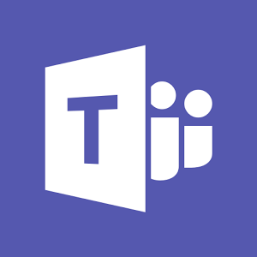
A more intelligent bot
Channels
Bot Application
luis.ai
Other Business Logic / Dialogs etc.
Luis Dialog
Model
API Controller
Notes:
There’s more , but these are the important ones

Slide 60
Demo
Home automation Bot
@jamesemann
Notes:
Introductions and Agenda (2 Mins)
Introduce Simon, Gary, James
Set expectations: intro to bot framework.
Very quick demo of JUST EAT to show what a bot is
What we are going to cover

Slide 61
Cards
@jamesemann
Notes:
Introductions and Agenda (2 Mins)
Introduce Simon, Gary, James
Set expectations: intro to bot framework.
Very quick demo of JUST EAT to show what a bot is
What we are going to cover

Slide 62
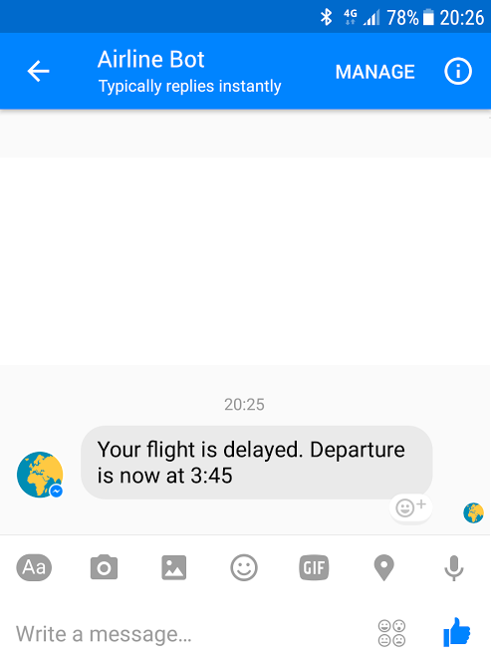
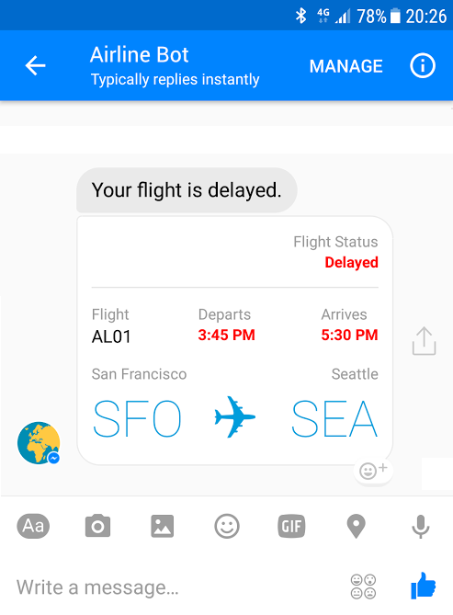
Bots can interact with more than just text
Notes:
There’s more , but these are the important ones

Slide 63
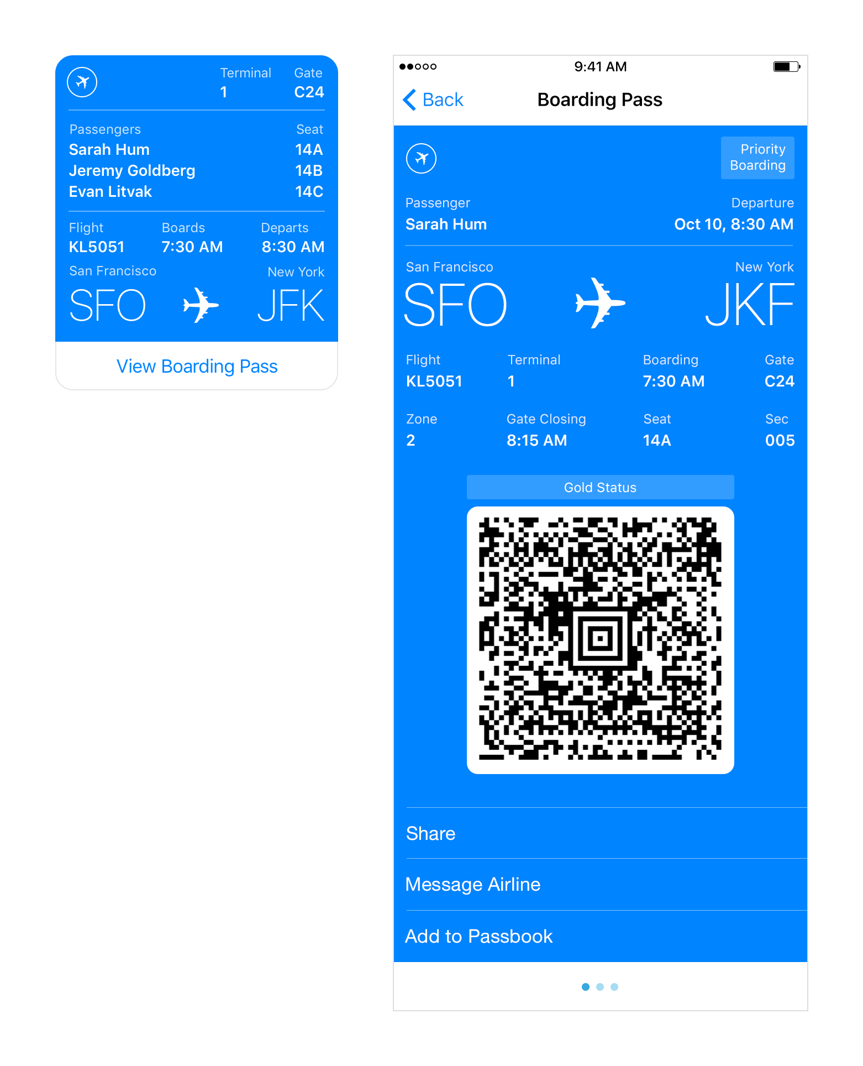
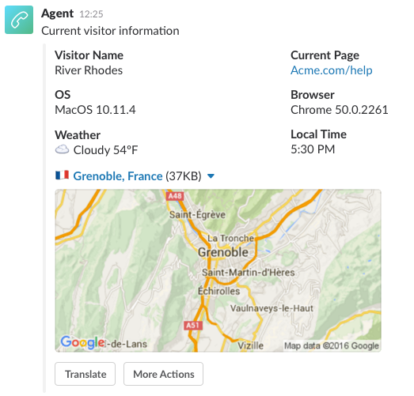
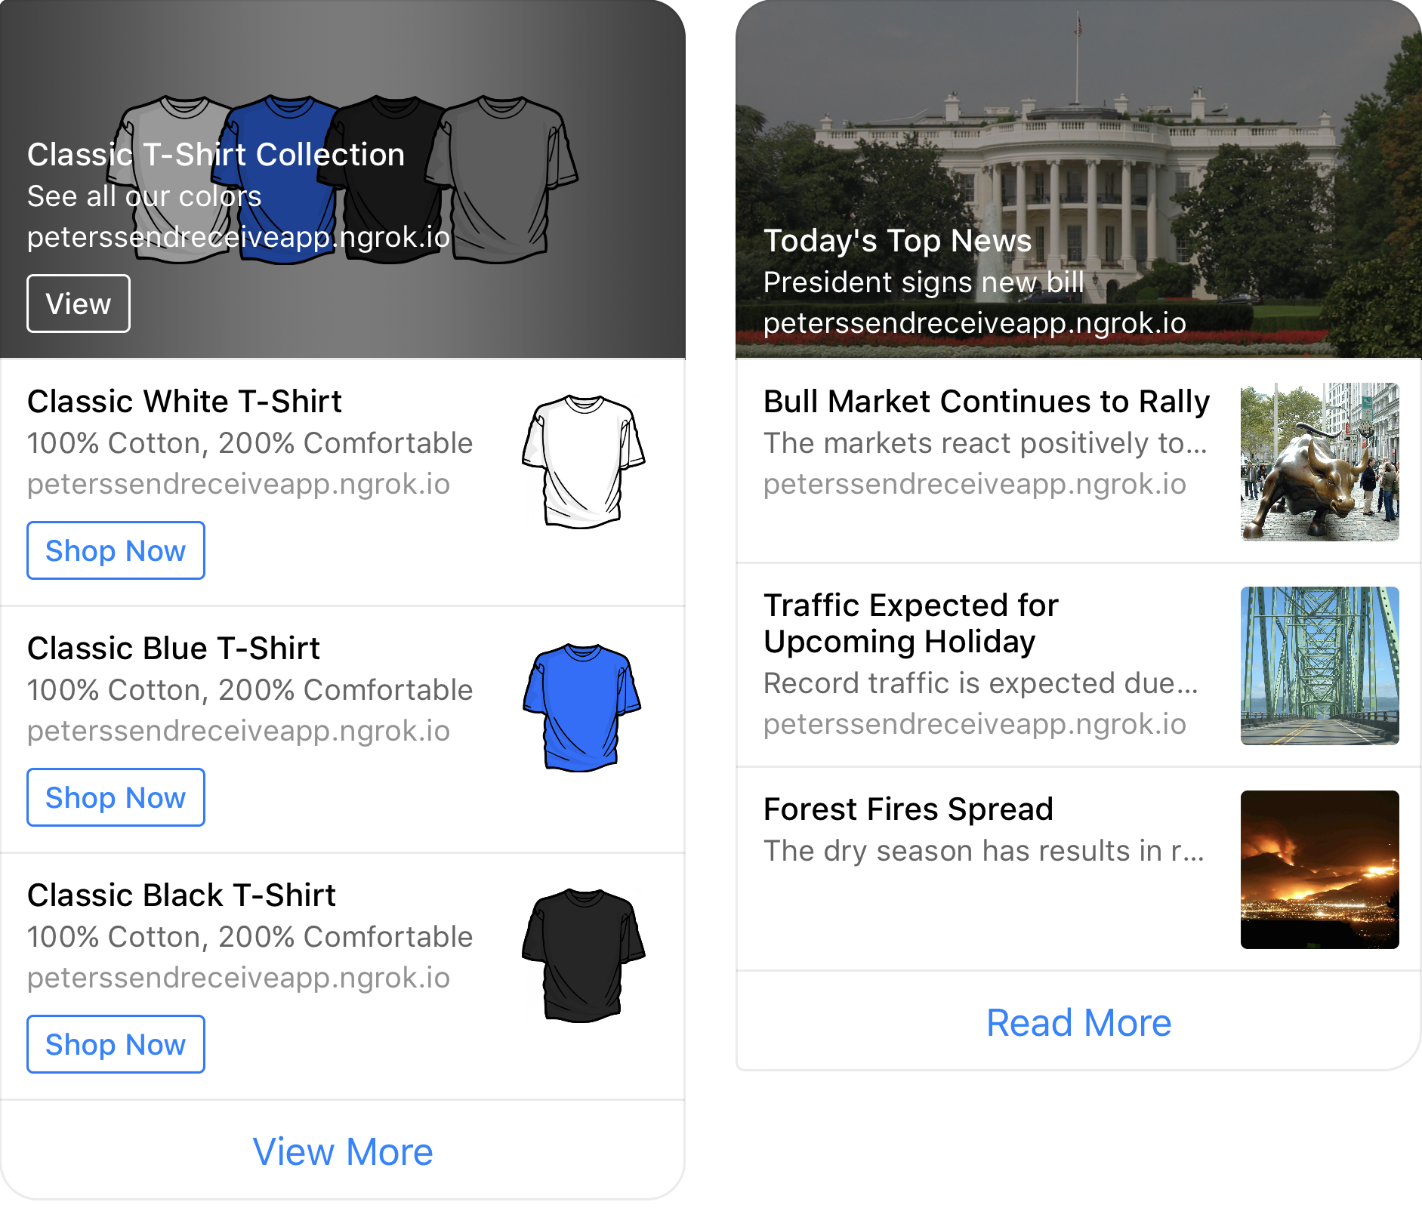
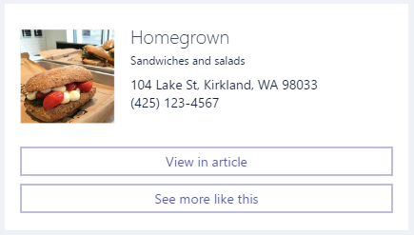
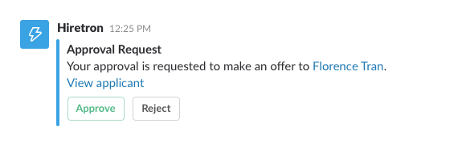
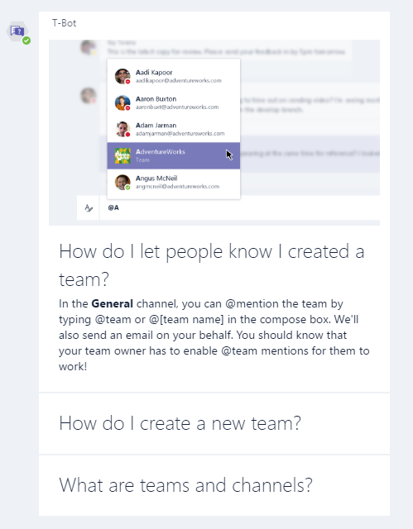
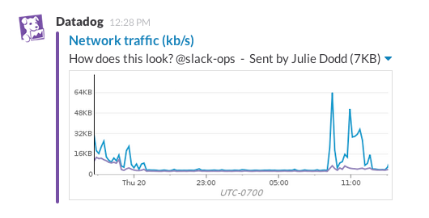
Notes:
There’s more , but these are the important ones

Slide 64
Creating cards using BotConnector
1. Create activity
2. Create card
3. Add the card to the activities
list of attachments.
IMessageActivity message = context.MakeMessage();
AdaptiveCard card = new AdaptiveCard();
card.Body.Add(new TextBlock()
{
Text = $"Appointment with doctor"
});
IMessageActivity message = context.MakeMessage();
message.Attachments.Add(new Attachment()
{
ContentType = AdaptiveCard.ContentType,
Content = card
});
Notes:
There’s more , but these are the important ones

Slide 65
Demo
Cards
@jamesemann
Notes:
Introductions and Agenda (2 Mins)
Introduce Simon, Gary, James
Set expectations: intro to bot framework.
Very quick demo of JUST EAT to show what a bot is
What we are going to cover

Slide 66
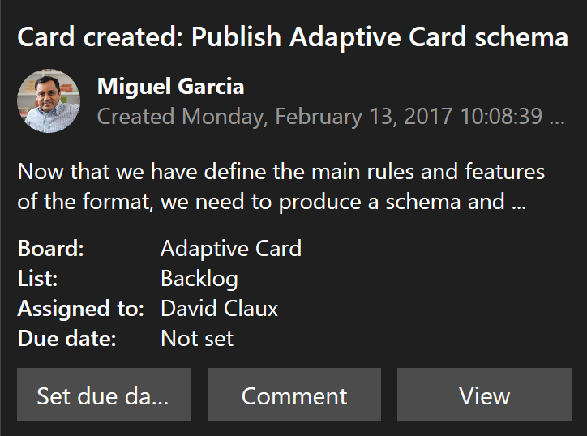




adaptivecards.io
A new standard for developers to create interactive cards
Define the structure of the card, and let the channel decide how to display it
Notification
Microsoft Teams
Skype
Android
IOS

Slide 67
Adaptive cards
Notification
Microsoft Teams
Skype
Android
IOS

Slide 68
Creating cards using ChannelData
1. Create activity
2. Create card using JSON
3. Assign the card to activity ChannelData
IMessageActivity message = context.MakeMessage();
JObject card = JObject.Parse(@"
{
""attachment"":
{
""type"": ""template"",
""payload"": {
""template_type"": ""airline_checkin"",
// ...
}
}
}");
message.ChannelData = card;
Notes:
There’s more , but these are the important ones

Slide 69
Demo
Facebook webview
@jamesemann
Notes:
Introductions and Agenda (2 Mins)
Introduce Simon, Gary, James
Set expectations: intro to bot framework.
Very quick demo of JUST EAT to show what a bot is
What we are going to cover

Slide 70
Proactive bots
@jamesemann
Notes:
Introductions and Agenda (2 Mins)
Introduce Simon, Gary, James
Set expectations: intro to bot framework.
Very quick demo of JUST EAT to show what a bot is
What we are going to cover

Slide 71
Bot communication isn’t always synchronous
Reminders and alerts
“Your flight is delayed”
Long running tasks
“Started the build… I’ll let you know when it’s done”
“The build is complete”
Human in the loop (human handoff)
Notes:
There’s more , but these are the important ones

Slide 72



Resuming a conversation
MICROSOFT

Slide 73
Demo
Customer support proactive Bot
@jamesemann
Notes:
Introductions and Agenda (2 Mins)
Introduce Simon, Gary, James
Set expectations: intro to bot framework.
Very quick demo of JUST EAT to show what a bot is
What we are going to cover

Slide 74
Thank you!
Create an account @ dev.botframework.com
Download the emulator + Node/C# SDK
Start providing a conversational interface to your existing apps!
https://github.com/jamesemann/dotnetnotts
Notes:
There’s more , but these are the important ones

Slide 75
Resources
Blogs:
James Mann:
blogs.blackmarble.co.uk/blogs/jmann/
Twitter:
@jamesemann
Useful links:
Bot samples, tutorials, case studies:
aka.ms/botresources
Bot framework:
dev.botframework.com
github.com/microsoft/BotBuilder
github.com/microsoft/BotBuilder-samples
Cognitive Services:
aka.ms/cognitive
MICROSOFT
Notes:
Introductions and Agenda (2 Mins)
Introduce Simon, Gary, James
Set expectations: intro to bot framework.
Very quick demo of JUST EAT to show what a bot is
What we are going to cover

